Slide 1


THE STATE-OF-THE-ART AND CHALLENGES OF DATA STREAM CLUSTERING ALGORITHMS IN PRACTICE
Jacob Montiel, Hoang-Anh Ngo, Minh-Huong Le Nguyen, Albert Bifet
IJCAI 2023, Macau SAR, China

Slide 2

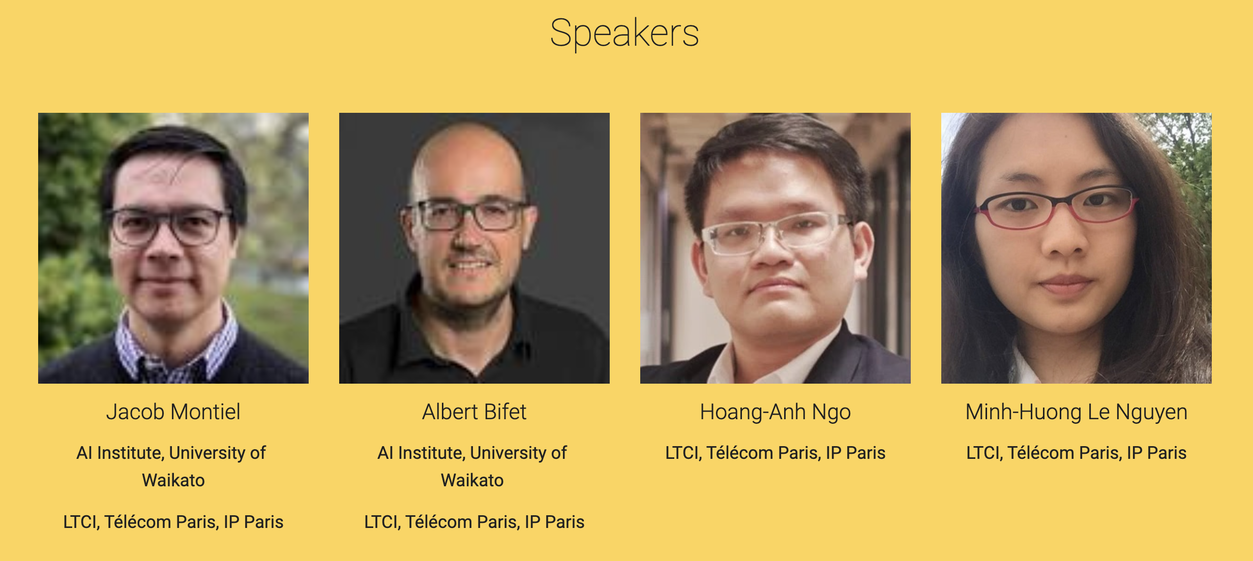
https://hoanganhngo610.github.io/stream-clustering.ijcai.2023/

Slide 3

OUTLINE
Introduction to ML for data streams.
Introduction to River.
Online clustering algorithms:
Challenges and Solutions;
Approaches;
State-of-the-art algorithms;
Further steps and personal insights.
Online clustering benchmarking with River.
https://hoanganhngo610.github.io/stream-clustering.ijcai.2023/

Slide 4

INTRODUCTION TO ML FOR DATA STREAMS

Slide 5


Slide 6
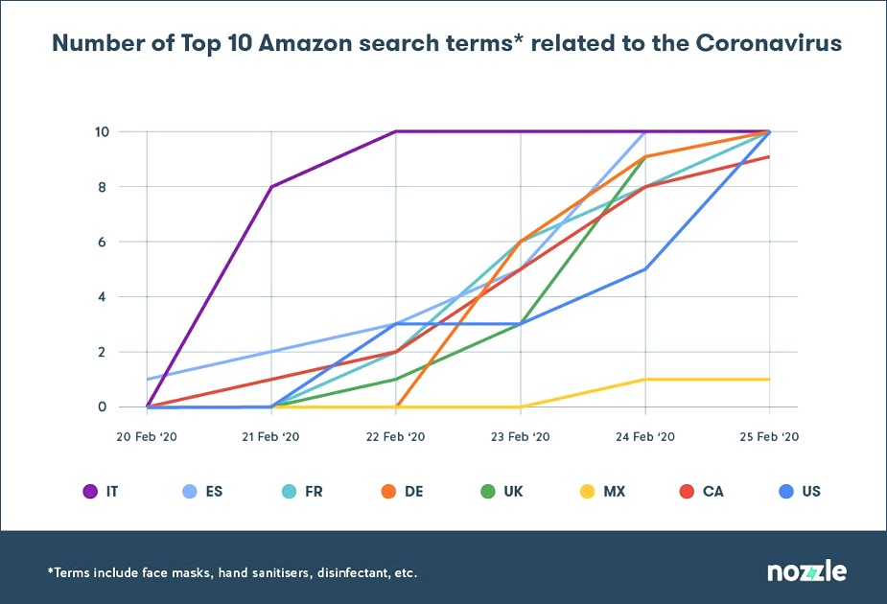
EXPOSED WEAKNESSES OF ML MODELS DURING THE COVID-19 PANDEMIC
“Normal has changed”: less than a week is needed for top 10 search terms to be filled with COVID-19-related products → Causing hiccups for models running behind-the-scene.
Machine learning models perform badly when input data are too different from trained data.

Slide 7
EXPOSED WEAKNESSES OF ML MODELS DURING THE COVID-19 PANDEMIC
The pandemic situation is so “volatile”, yet if “A machine learning system doesn’t see what it’s expecting to see, then you will have problems.”
→ Human input is extremely needed.

Slide 8


ANALYTIC STANDARD APPROACH
Data Set
Classifier Algorithm
builds Model
Model
Finite training sets Static models

Slide 9
ML STANDARD APPROACH
Data Stream
Train Model
Train Model
Problem: how often and how much data to use to build the model
Finite training sets Static models

Slide 10
DATA STREAM APPROACH
D S
DS
DS
DS
DS
DS
DS
DS
DS
DS
DS
DS
Update
Model
M
M
M
M
M
M
M
M
M
M
M
M
Infinite training sets Dynamic models
*DS: Data set, M: Model

Slide 11
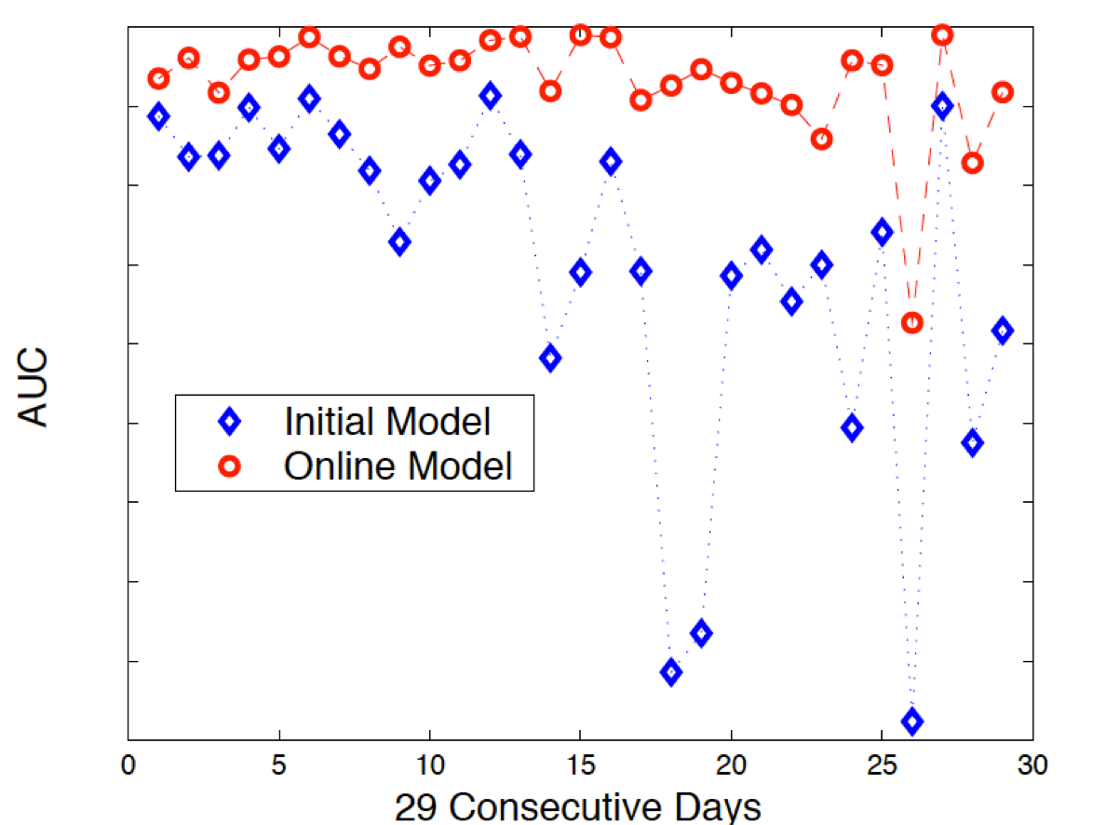
PAIN POINTS
Need to retrain!
Things change over time
How often?
Data unused until next update!
Value of data wasted

Slide 12
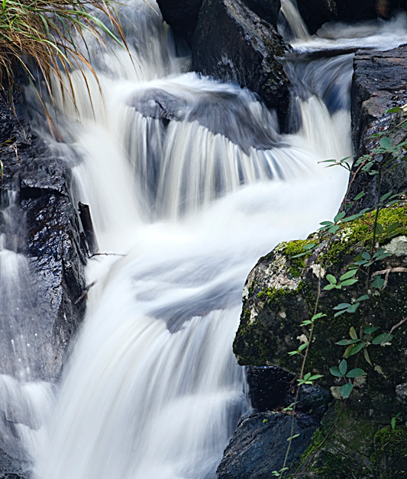
STREAM MINING
Maintain models online
Incorporate data on the fly
Unbounded training sets
Resource efficient
Detect changes and adapts
Dynamic models

Slide 13
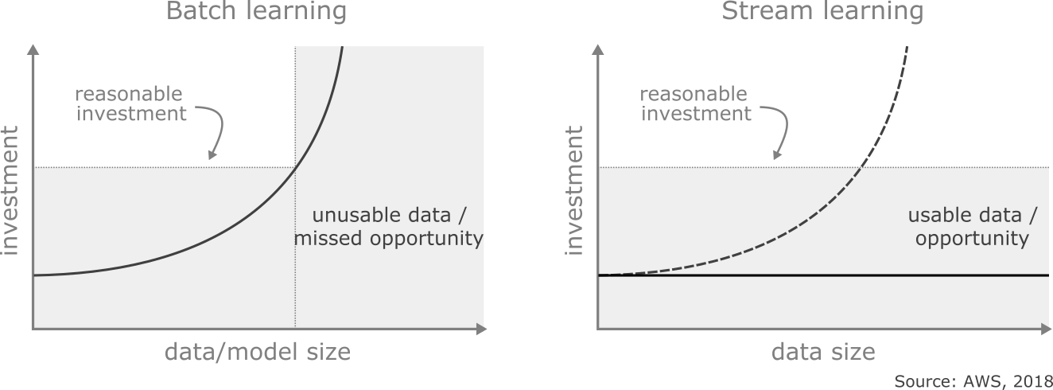
INVESTMENT VS DATA SIZE
Batch learning
Often struggles to maintain investment
(time, memory, cost) below reasonable level
Stream learning
Efficiently generates incremental models from data streams

Slide 14
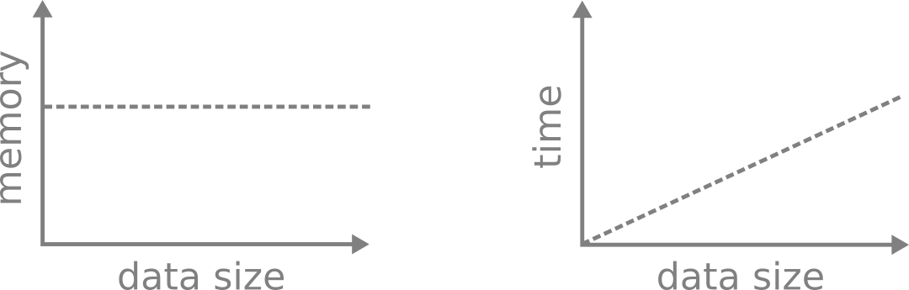
RESOURCES Stream learning upper limits
constant memory
sub-linear processing time (training)

Slide 15
REQUIREMENTS
Process one sample at a time, and inspect it only once
Use a limited amount of memory
Work in a limited amount of time
Always ready to predict

Slide 16
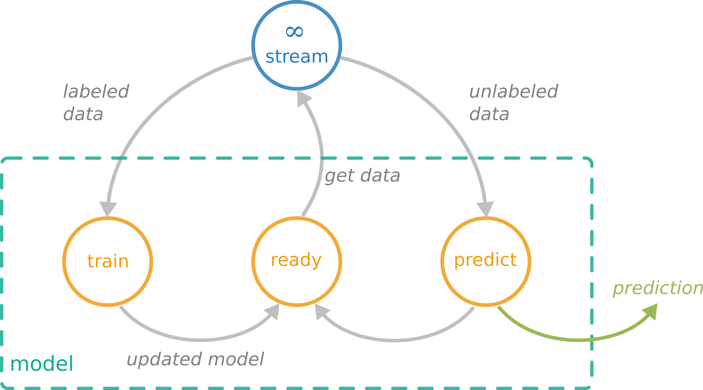
LEARNING FROM DATA STREAMS Supervised learning
One sample at a time
Limited resources
Predict at any time

Slide 17
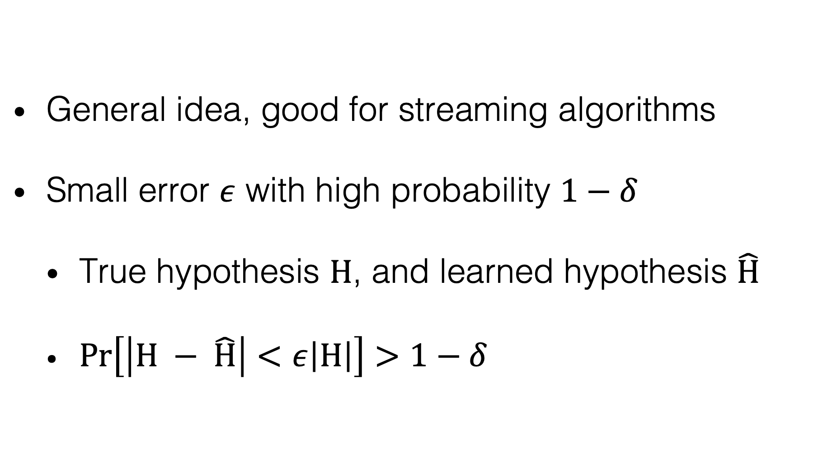
APPROXIMATION ALGORITHMS
General idea, good for streaming algorithms
Small error $ε$ with high probability $1−δ$
True hypothesis $H$, and learned hypothesis $\hat{H}$
$Pr\left[\left|H − \hat{H}\right|<ε\left|H\right|\right]>1−δ$

Slide 18
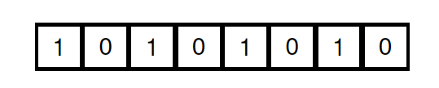
APPROXIMATION ALGORITHMS
What is the largest number that we can store in 8 bits?

Slide 19
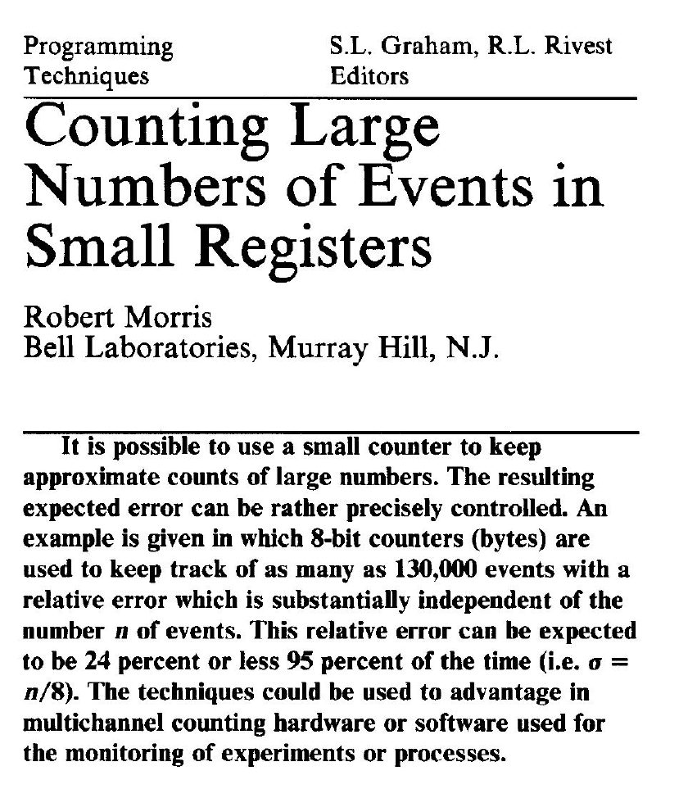
APPROXIMATION ALGORITHMS
What is the largest number that we can store in 8 bits?
Robert Morris. 1978. Counting large number of events in small registers. Communications of the ACM, 21, 10 (1978), 840-842. https://doi.org/10.1145/359619.359627

Slide 20
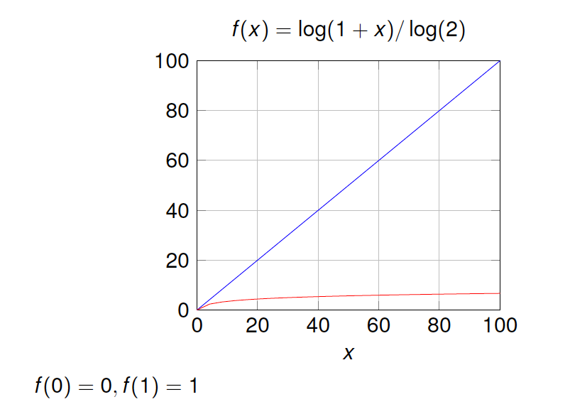
APPROXIMATION ALGORITHMS
What is the largest number that we can store in 8 bits?

Slide 21
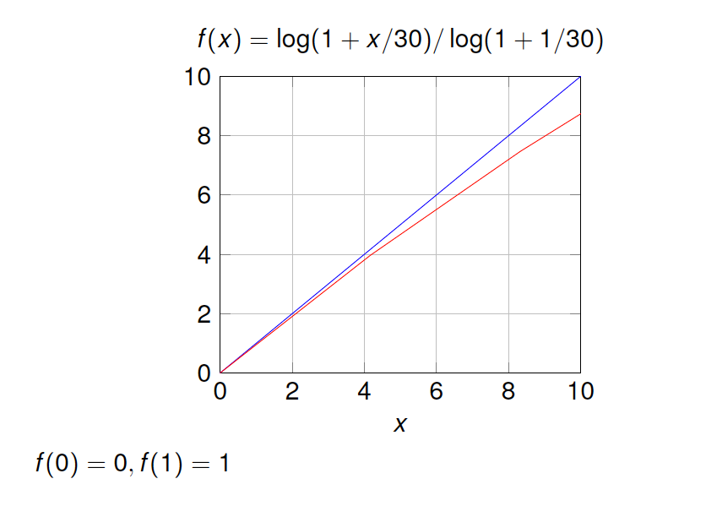
APPROXIMATION ALGORITHMS
What is the largest number that we can store in 8 bits?

Slide 22
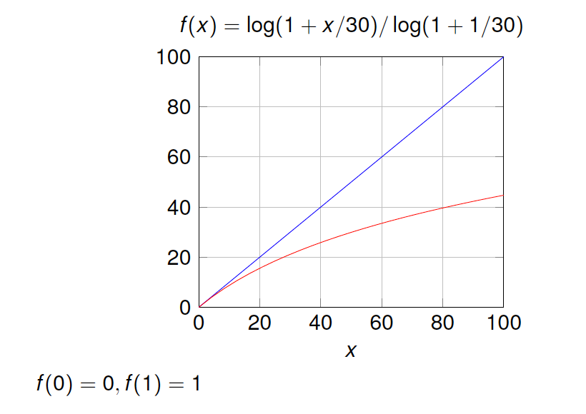
APPROXIMATION ALGORITHMS
What is the largest number that we can store in 8 bits?

Slide 23
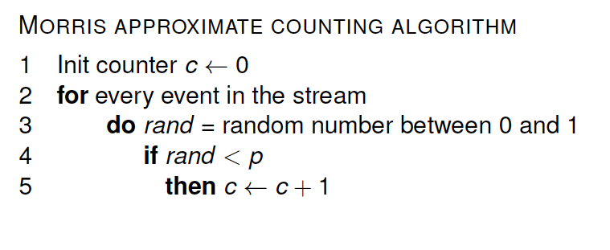
APRPOXIMATION ALGORITHMS
What is the largest number that we can store in 8 bits?

Slide 24
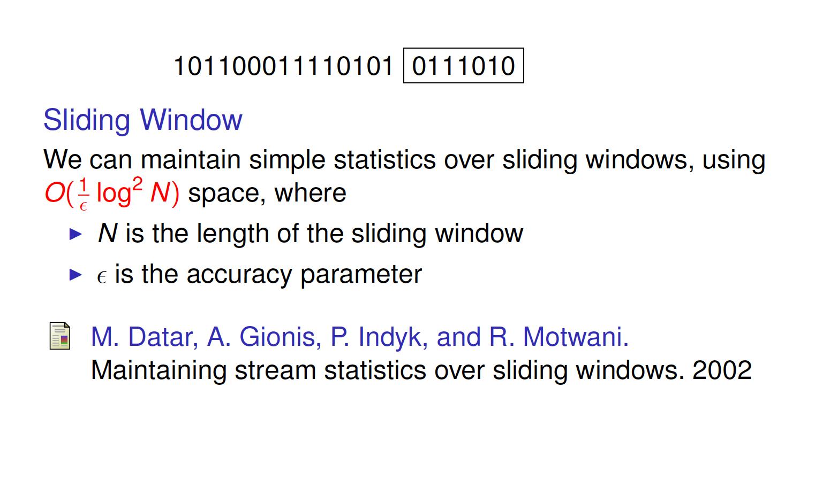
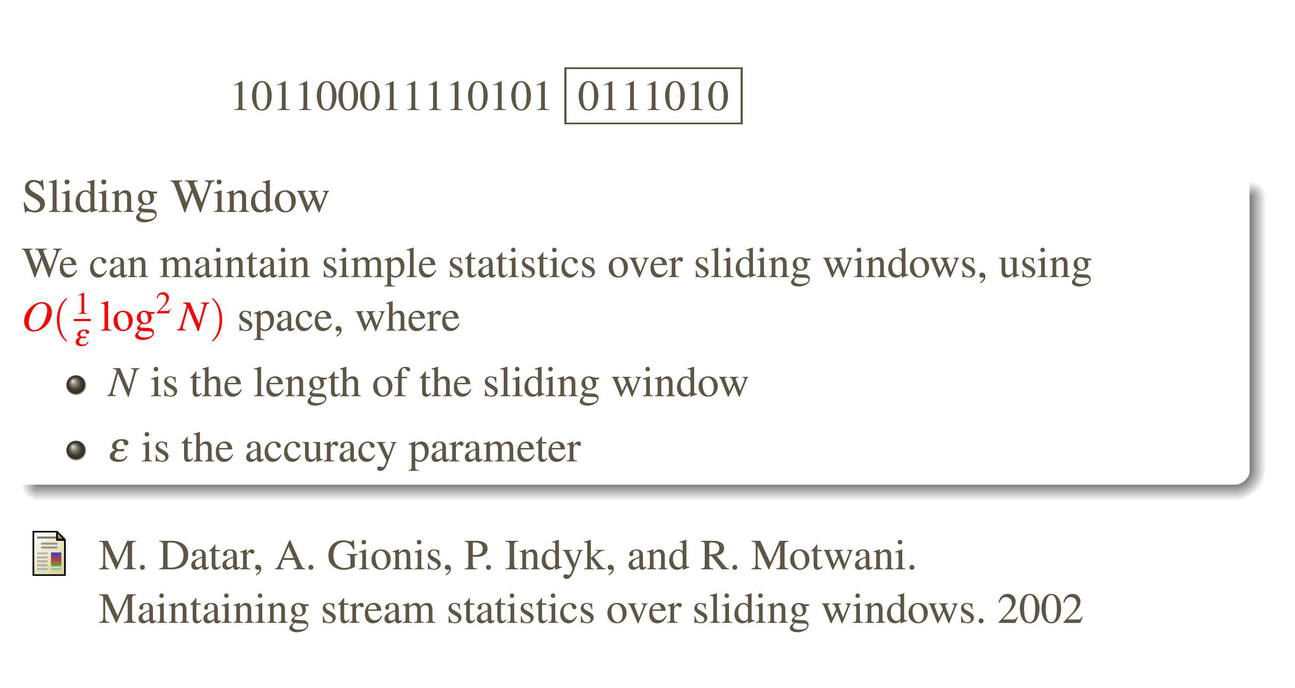
APPROXIMATION ALGORITHMS

Slide 25
CLASSIFICATION

Slide 26
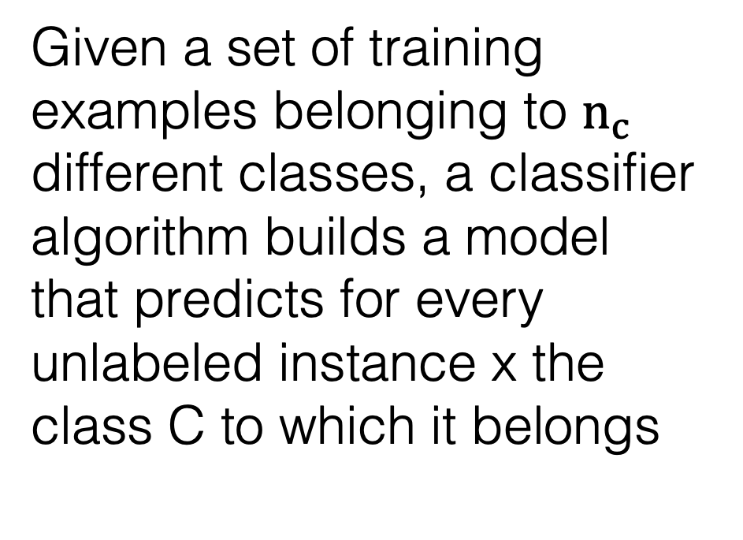
DEFINITION
Given a set of training examples belonging to $n_{c}$ different classes, a classifier algorithm builds a model that predicts for every unlabeled instance x the class C to which it belongs
EXAMPLES
Email spam filter
Twitter sentiment analyzer
Photo: Stephen Merity http://smerity.com

Slide 27
SAM-kNN
Viktor Losing, Barbara Hammer, and Heiko Wersing. 2016. KNN Classifier with Self Adjusting Memory for Heteogenerous Concept Drift. In: Proceedings of the 16th International Conference on Data Mining (ICDM), (Barcelona, Spain), 291-300. https://doi.org/10.1109/ICDM.2016.0040
Received Best Paper Awards.

Slide 28
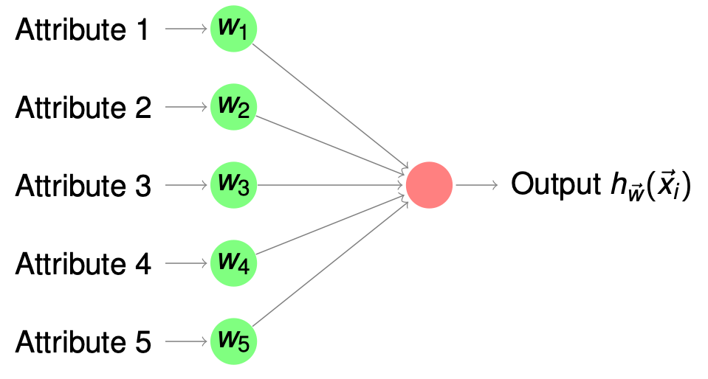
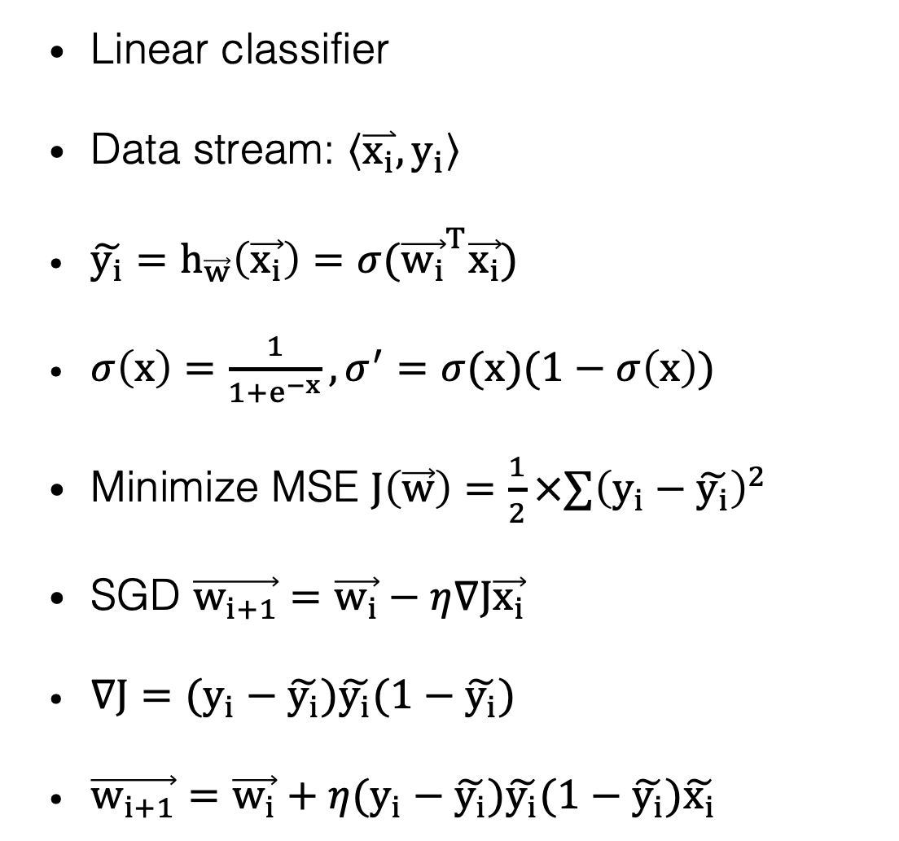
PERCEPTRON
Linear classifier
Data stream: $\left\langle \overset{⃑}{x_{i}}, y_{i}\right\rangle$
$\tilde{y_{i}}=h_{\vec{w}}\left(\vec{x_{i}}\right)=σ({\vec{w_{i}}}^{T}\vec{x_{i}})$
$σ\left(x\right)=\frac{1}{1+e^{−x}}, σ^{′}=σ(x)(1−σ\left(x\right))$
Minimize MSE $J\left(\vec{w}\right)=\frac{1}{2}×∑{\left(y_{i}−\tilde{y_{i}}\right)}^{2}$
SGD $\vec{w_{i+1}}=\vec{w_{i}}−η∇J\vec{x_{i}}$
$∇J=(y_{i}−\tilde{y_{i}})\tilde{y_{i}}(1−\tilde{y_{i}})$
$\vec{w_{i+1}}=\vec{w_{i}}+η(y_{i}−\tilde{y_{i}})\tilde{y_{i}}(1−\tilde{y_{i}})\tilde{x_{i}}$

Slide 29
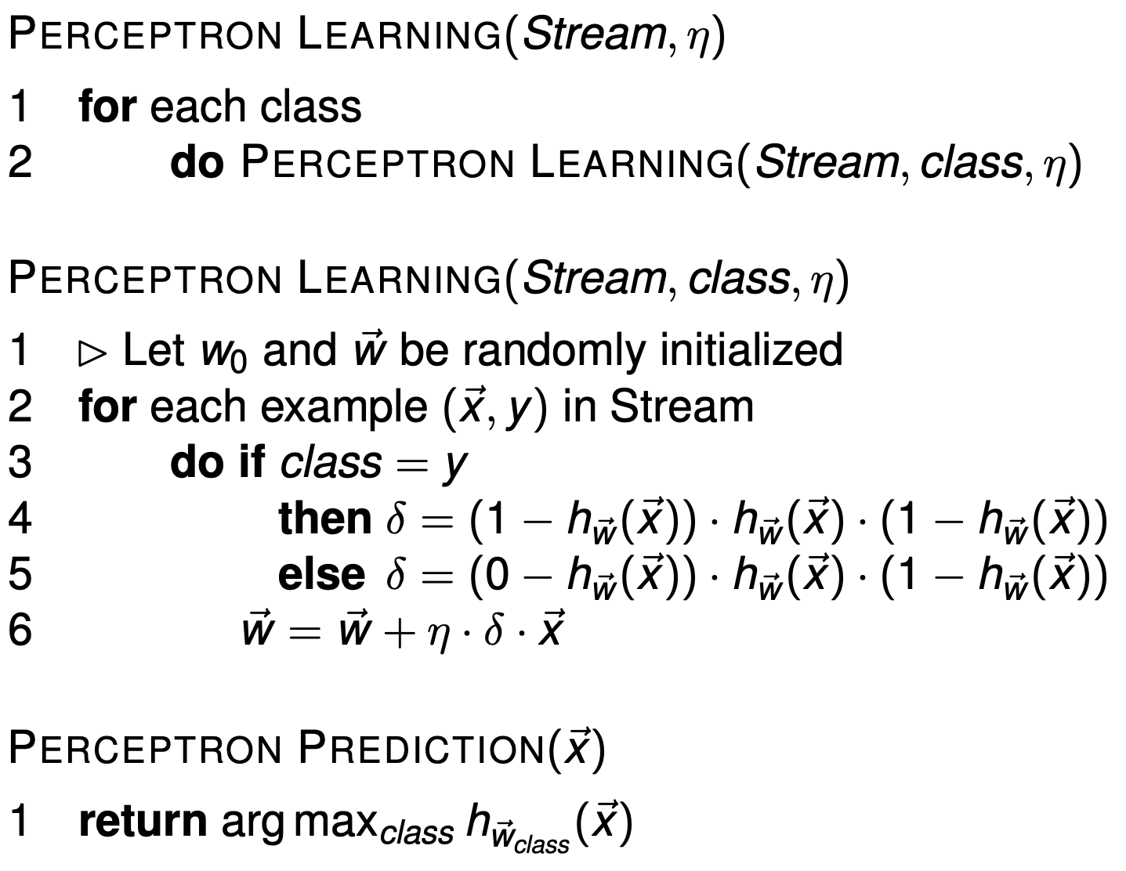
PERCEPTRON LEARNING

Slide 30
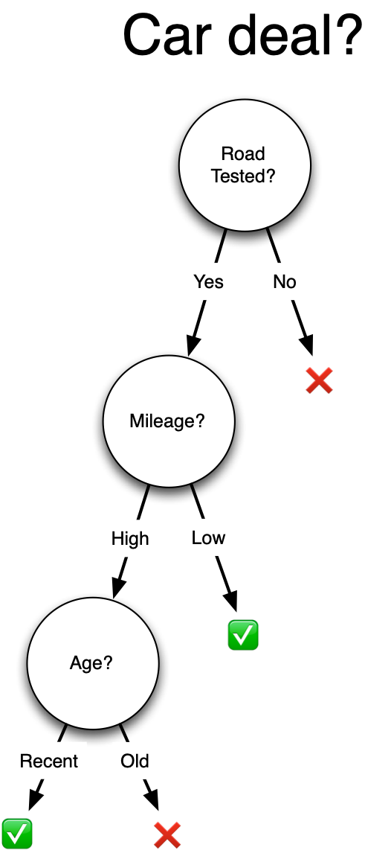
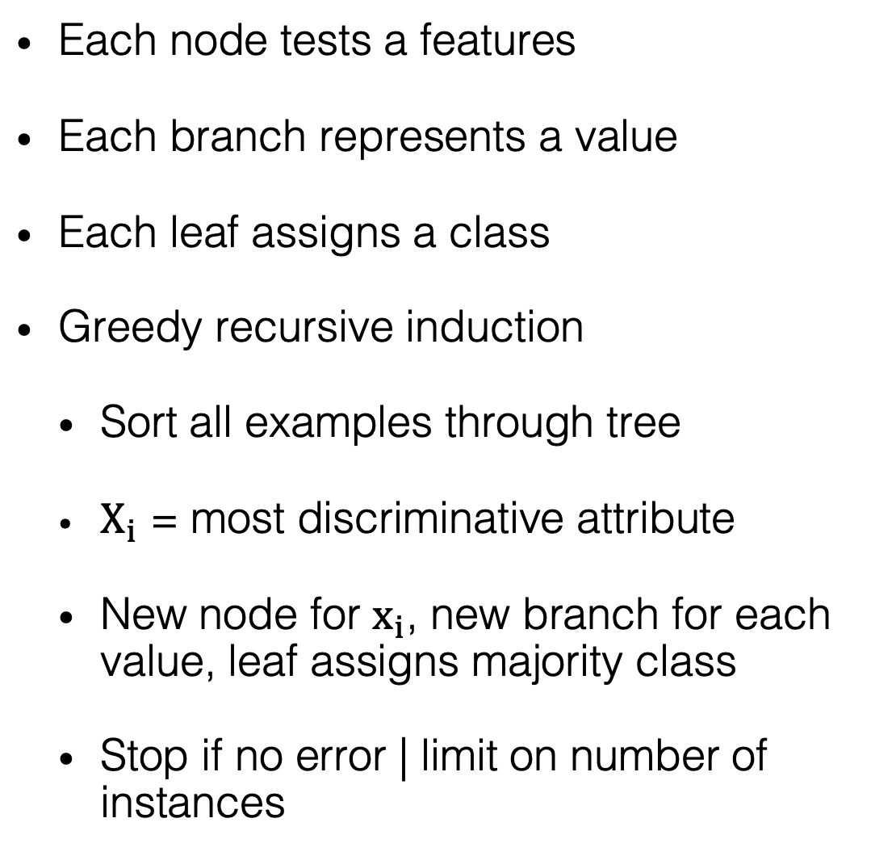
DECISION TREE
Each node tests a features
Each branch represents a value
Each leaf assigns a class
Greedy recursive induction
Sort all examples through tree
$X_{i}$ = most discriminative attribute
New node for $x_{i}$, new branch for each value, leaf assigns majority class
Stop if no error | limit on number of instances

Slide 31
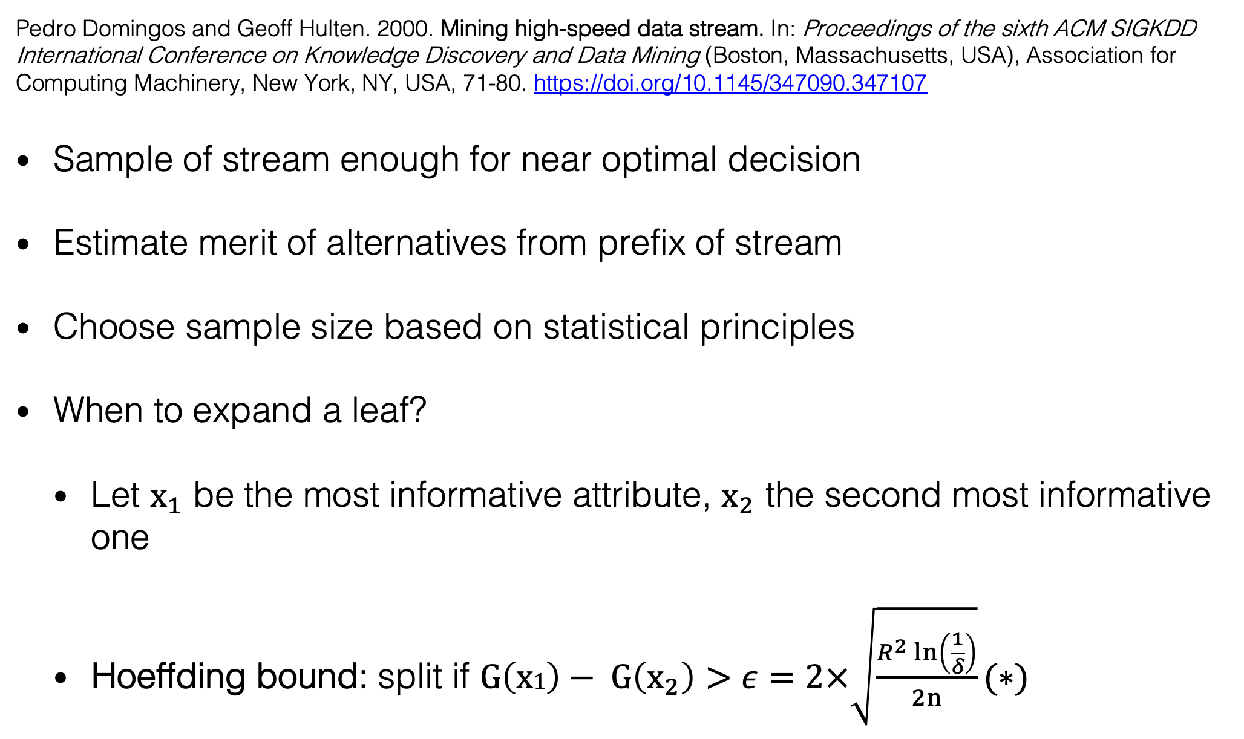
Hoeffding Tree
Pedro Domingos and Geoff Hulten. 2000. Mining high-speed data stream. In: Proceedings of the sixth ACM SIGKDD International Conference on Knowledge Discovery and Data Mining (Boston, Massachusetts, USA), Association for Computing Machinery, New York, NY, USA, 71-80. https://doi.org/10.1145/347090.347107
Sample of stream enough for near optimal decision
Estimate merit of alternatives from prefix of stream
Choose sample size based on statistical principles
When to expand a leaf?
Let $x_{1}$ be the most informative attribute, $x_{2}$ the second most informative one
Hoeffding bound: split if $G\left(x1\right)− G\left(x_{2}\right)>ε=2×\sqrt{\frac{R^{2}\ln\left(\frac{1}{δ}\right)}{2n}}(∗)$
$(∗)$ This bound has been corrected in a recent paper: Pawel Matuszyk, Georg Krempl, and Myra Spiliopoulou. Correcting the Usage of the Hoeffding Inequality in Stream Mining. In: IDA 2013: Advances in Intelligent Data Analysis, 298-309. https://doi.org/10.1007/978-3-642-41398-8_26
Notes:
Bounded difference from greedy heuristic

Slide 32
ADAPTIVE RANDOM FOREST
Why Random Forests?
Off-the-shelf learner
Good learning performance
Heitor M. Gomes, Albert Bifet, Jesse Read, Jean Paul Barddal, Fabrício Enembreck, Bernhard Pfharinger, Geoff Holmes & Talel Abdessalem. 2017. Adaptive random forests for evolving data streams classification. Machine Learning 106 (2017), 1469-1495. https://doi.org/10.1007/s10994-017-5642-8
Based on the original Random Forest by Leo Breiman
Leo Breiman. 2001. Random Forests. Machine Learning 45 (2001), 5-32. https://doi.org/10.1023/A:1010933404324

Slide 33
ADAPTIVE RANDOM FOREST
Leveraging bagging
Random Hoeffding Trees
Random subsets of features for splits
Independent (can train in parallel)
Adaptive Learning
1 drift and 1 warning detector per tree
Train trees in the background before adding them

Slide 34
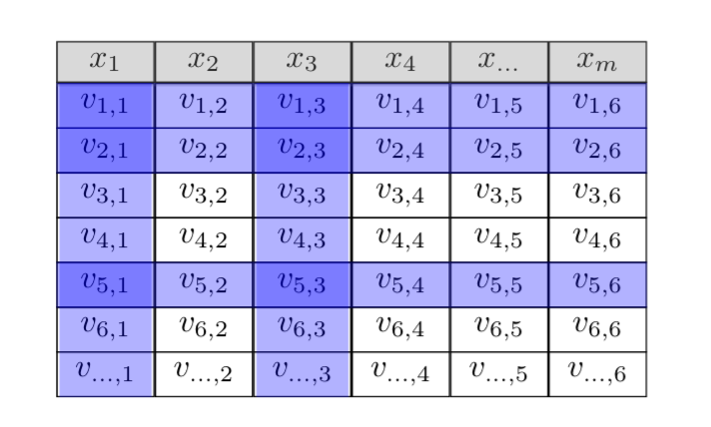
STREAMING RANDOM BATCHES
Heitor Murilo Gomes, Albert Bifet, and Jesse Read. Streaming Random Patches for Evolving Data Stream Classification. In: Proceedings of the 2019 IEEE International Conference on Data Mining (ICDM), 240-249. https://doi.org/10.1109/ICDM.2019.00034

Slide 35
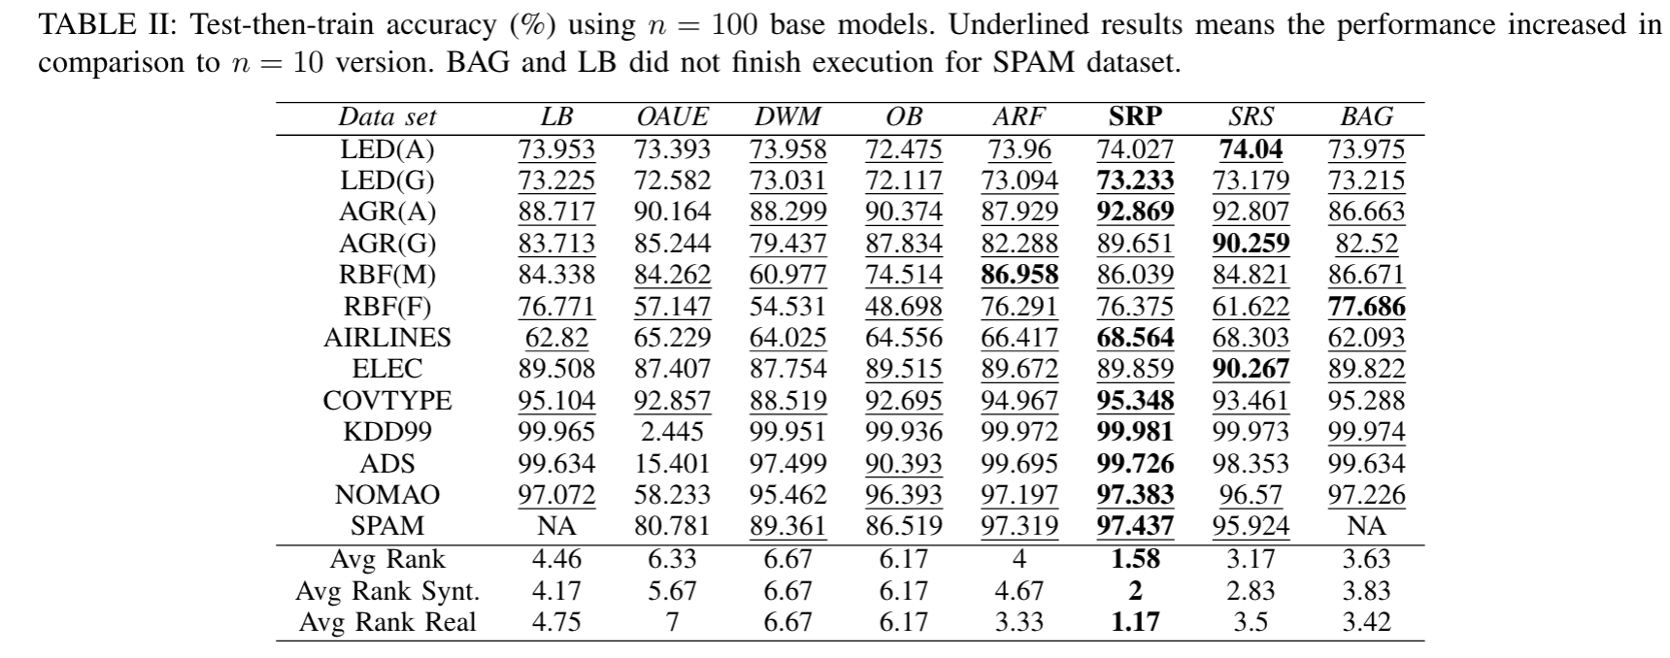
STREAMING RANDOM BATCHES
Heitor Murilo Gomes, Albert Bifet, and Jesse Read. Streaming Random Patches for Evoving Data Stream Classification. In: Proceedings of the 2019 IEEE International Conference on Data Mining (ICDM), 240-249. https://doi.org/10.1109/ICDM.2019.00034

Slide 36


Jacob Montiel, Max Halford, Saulo Martiello Mastelini, Geoffrey Bolmier, Raphael Sourty, Robin Vaysse, Adil Zouitine, Heitor Murilo Gomes, Jesse Read, Talel Abdessalem, and Albert Bifet. 2021. River: machine learning for streaming data in Python. Journal of Machine Learning Research 22 (April 2021), 1–8. http://jmlr.org/papers/v22/20-1380.html
A Python library for stream learning
Incremental + adaptive methods
Supervised learning Classification, Regression
Unsupervised learning Anomaly detection*, Clustering
Drift detection
Pipelines / Data transformers
Evaluation / Metrics
etc.

Slide 37

DESIGN PRINCIPLES
Pythonic
Easy to use (any expertise level)
Easy to extend
Intended to work with other tools in the Python ecosystem
Users: researchers and practitioners

Slide 38
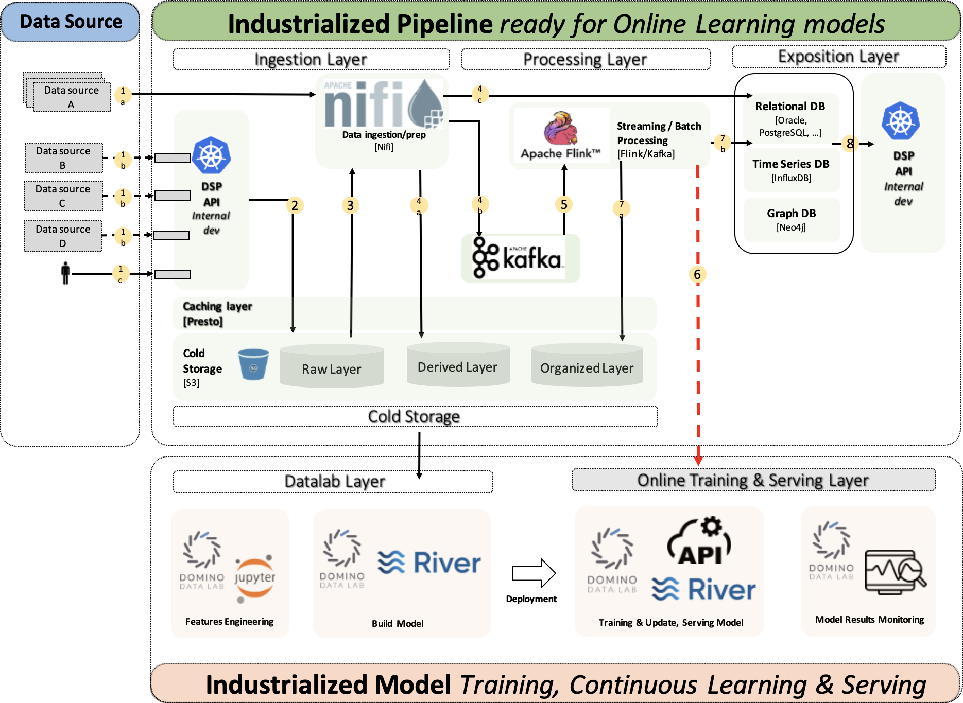
USE CASE: BNP PARIBAS
Marriam Barry and Albert Bifet and Raja Chiky and Jacob Montiel and Vinh-Thuy Tran. Challenges of Machine Learning for Data Streams in Banking Industry. In: BDA 2021: Big Data Analytics. Springer, 106-118. https://doi.org/10.1007/978-3-030-93620-4_9
Proof of concept.
"...a platform architecture used to deploy online learning models in a production environment and at a large scale."

Slide 39
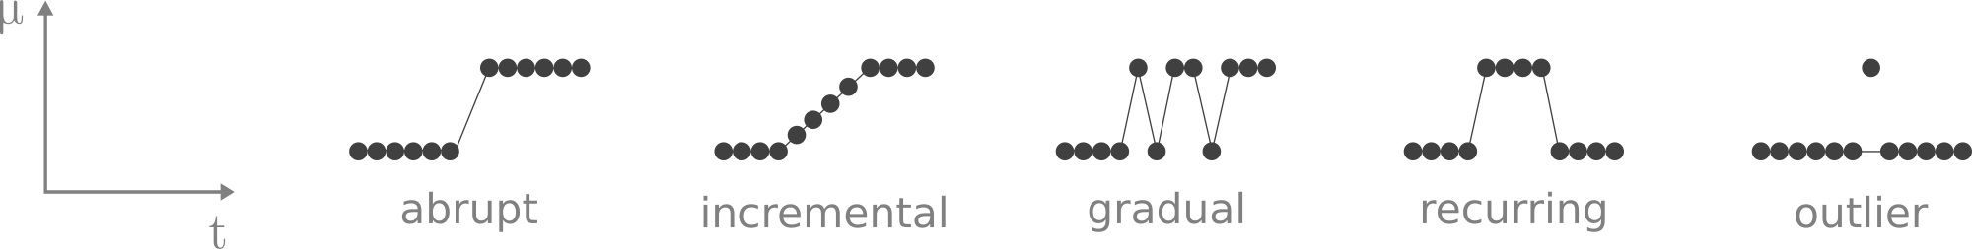
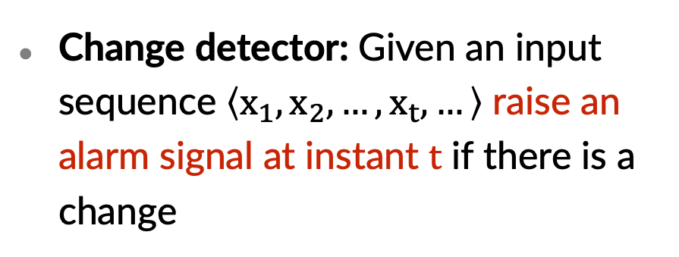
CONCEPT DRIFT
Joao Gama and Indre Zliobaite, Albert Bifet, Mikola Pechenizkiy and Abdelhamid Bouchachia. A survey on Concept Drift Detection. ACM Computing Surveys 46, 4 (2014), 1-37. https://doi.org/10.1145/2523813
In dynamic and non-stationary environments, the data distribution can change over time.
Change detector: Given an input sequence $\left\langle x_{1},x_{2},…, x_{t},…\right\rangle$ raise an alarm signal at instant $t$ if there is a change
Application: Detect changes in model performance

Slide 40
ONLINE CLUSTERING ALGORITHMS

Slide 42

DEFINITION
Given a set of unlabeled instances, distribute them into homogeneous groups according to some common relations or affinities
Photo source: W. Kandinsky - Several Circles (edited)
EXAMPLES
Market segmentation
Social network communities

Slide 43
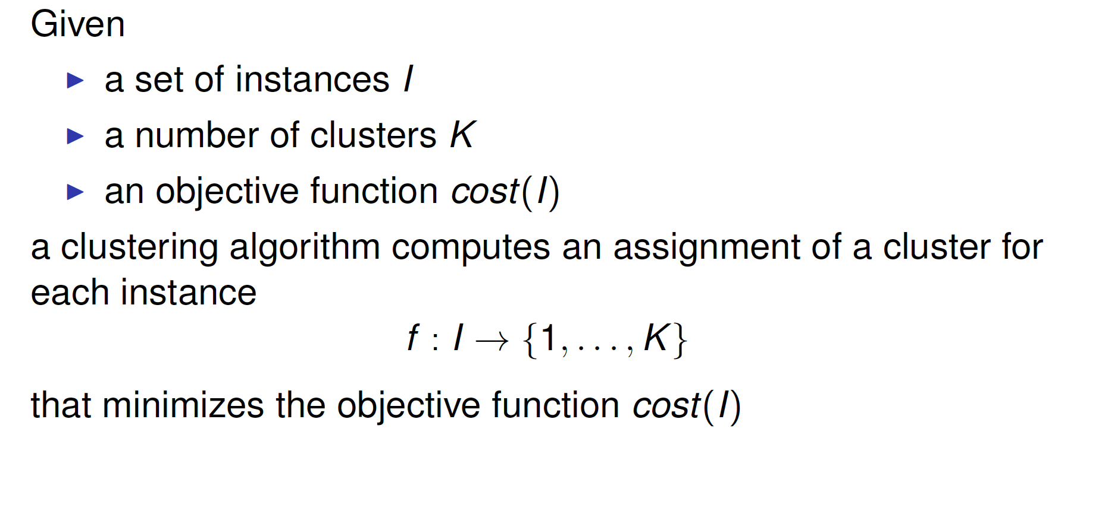
CLUSTERING

Slide 44
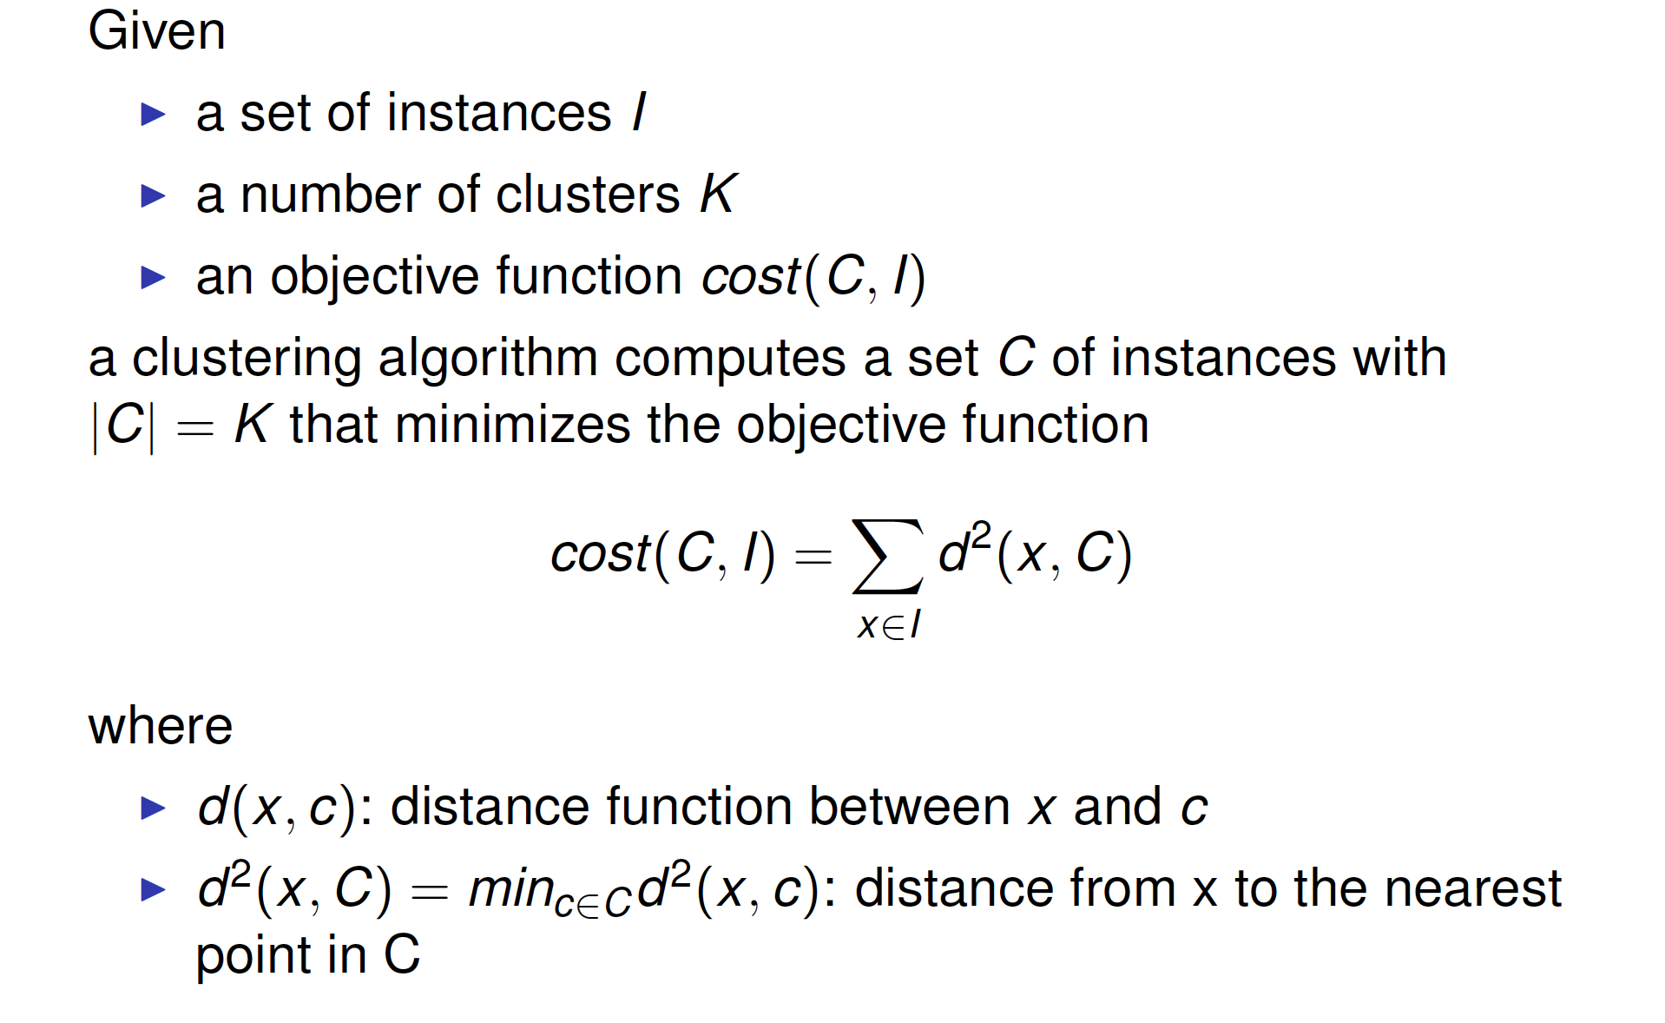
CLUSTERING

Slide 45
AVAILABLE SOFTWARES
Very few implementations (only most prominent ones) and unified frameworks with multiple algorithms co-existing:
Massive Online Analysis (MOA): Most popular framework, written by Bifet et al. (2010) in Java, including the most number (7) of clustering algorithms. However, one major disadvantage: only works well when information of data streams are previously known.
stream package: Written in R by Hahsler et al. (2018), with newer algorithms including D-Stream, DBSTREAM and evoStream.

Slide 46
AVAILABLE SOFTWARES
Very few implementations (only most prominent ones) and unified frameworks with multiple algorithms co-existing:
Subspace MOA framework: An extension of MOA from Java into R, written by Hassani et al. (2016), with extra algorithms including HDDStream and PreDeConStream.
streamDM: Written by Huawei Noah’s Ark Lab (2015) with Spark Streaming, an extension of Spark engine. Including CluStream and StreamKM++, but no plans for any further implementation

Slide 47
SOLUTION – RIVER
→ River comes into play, with a neat implementation that allows:
Works with any arbitrary numerical data stream;
Well-maintained, documented and includes various algorithms of different types.
Currently, River offers 6 clustering algorithms, including incremental K-Means, CluStream, DenStream, DBSTREAM, StreamKMeans (O'Callaghan et al., 2002) and evoStream with a clear plan of further implementations.
Includes the most number of clustering algorithms apart from MOA.

Slide 48
STRATEGY
Basically, finding clustering solutions is an optimization task, with the following principle strategies:
Minimizing intra-cluster distances or radii of clusters (ensuring that objects within the same cluster are similar);
Maximizing inter-cluster distances or heterogeneity (ensuring that objects within different clusters are well-separated);
Maximizing likelihood estimates

Slide 49
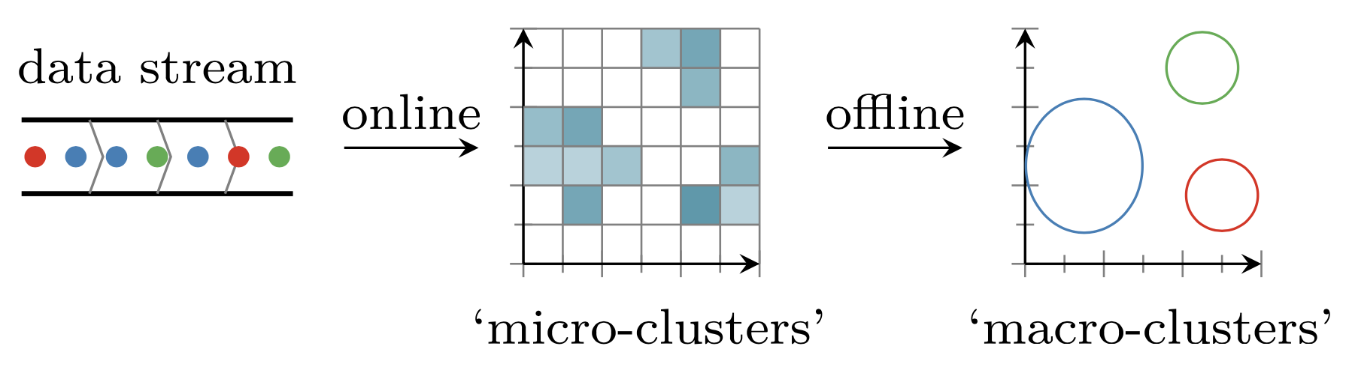
ARISING PROBLEMS
In online clustering, historical data will be discarded and only information of formed clusters (cluster centers, number of points, linear sum, sum of squares, etc.) will be saved → Clustering algorithms are divided into two phases: ONLINE phase and OFFLINE phase.
Two-phase stream clustering with grid-based approach
(Source: Matthias Carnein et al. 2017. An empirical comparison of stream clustering algorithms.)

Slide 50
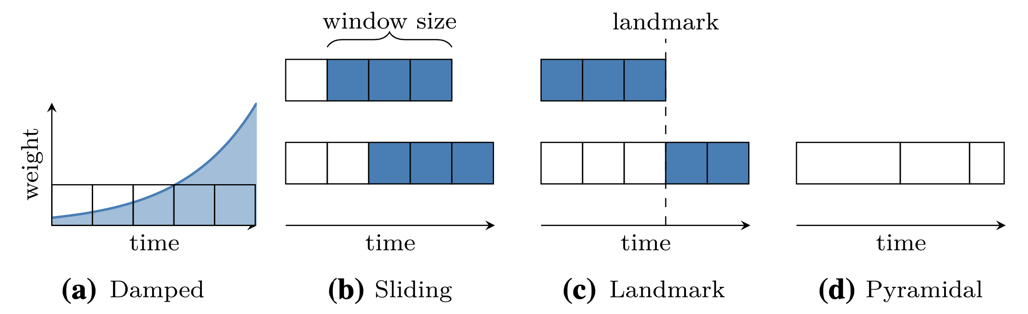
ARISING PROBLEMS
Through time, the distribution of the stream will change. (also known as drift or concept drift) → Models can employ time-window models, which only keeps the most few recent data points to avoid bias. This approach can include damped, sliding, landmark or pyramidal models.
Two-phase stream clustering with grid-based approach
(Source: Zhu Y. and Shasha D. 2002. Statstream: statistical monitoring of thousands of data streams in real life
and Silva J. A. et al. 2013. Data stream clustering: a survey.)

Slide 51
APPROACHES
Matthias Carnein and Heike Trautmann. 2019. Optimizing Data Stream Representation: An Extensive Survey on Stream Clustering Algorithms. Business and Information Systems Engineering 61, 3 (2019), 277-297. https://doi.org/10.1007/s12599-019-00576-5
Distance-based approach: threshold the distance of the new observation to existing clusters, either to insert or initialize new clusters, including:
Clustering Features (CFs), Extended CFs, Time-Fading CFs: BIRCH, CluStream, SDStream, ClusTree;
Centroids, Medoids: StreamKM++, STREAM;
Competitive Learning: DBSTREAM.
Density-based (Grid-based) approach: capture the density of observation in a grid, by separating the data space among all dimension, including:
One-time or recursive partitioning: DUCStream, D-Stream, Stats-Grid;
Hybrid Grid-Approach: HDCStream, Mudi-Stream;

Slide 52
APPROACHES
Matthias Carnein and Heike Trautmann. 2019. Optimizing Data Stream Representation: An Extensive Survey on Stream Clustering Algorithms. Business and Information Systems Engineering 61, 3 (2019), 277-297. https://doi.org/10.1007/s12599-019-00576-5
Model-based approach: Summarize the data stream as a statistical model, with a common area of research based on the Expectation Maximization (EM) algorithm. Including CluDisStream, SWEM, COBWEB, Wstream, etc.
Projected approach: This special approach deals with high dimensional data stream, addressing the curse of dimensionality. Including HPStream, HDDStream, and PreDeConStream along with their extensions.

Slide 53
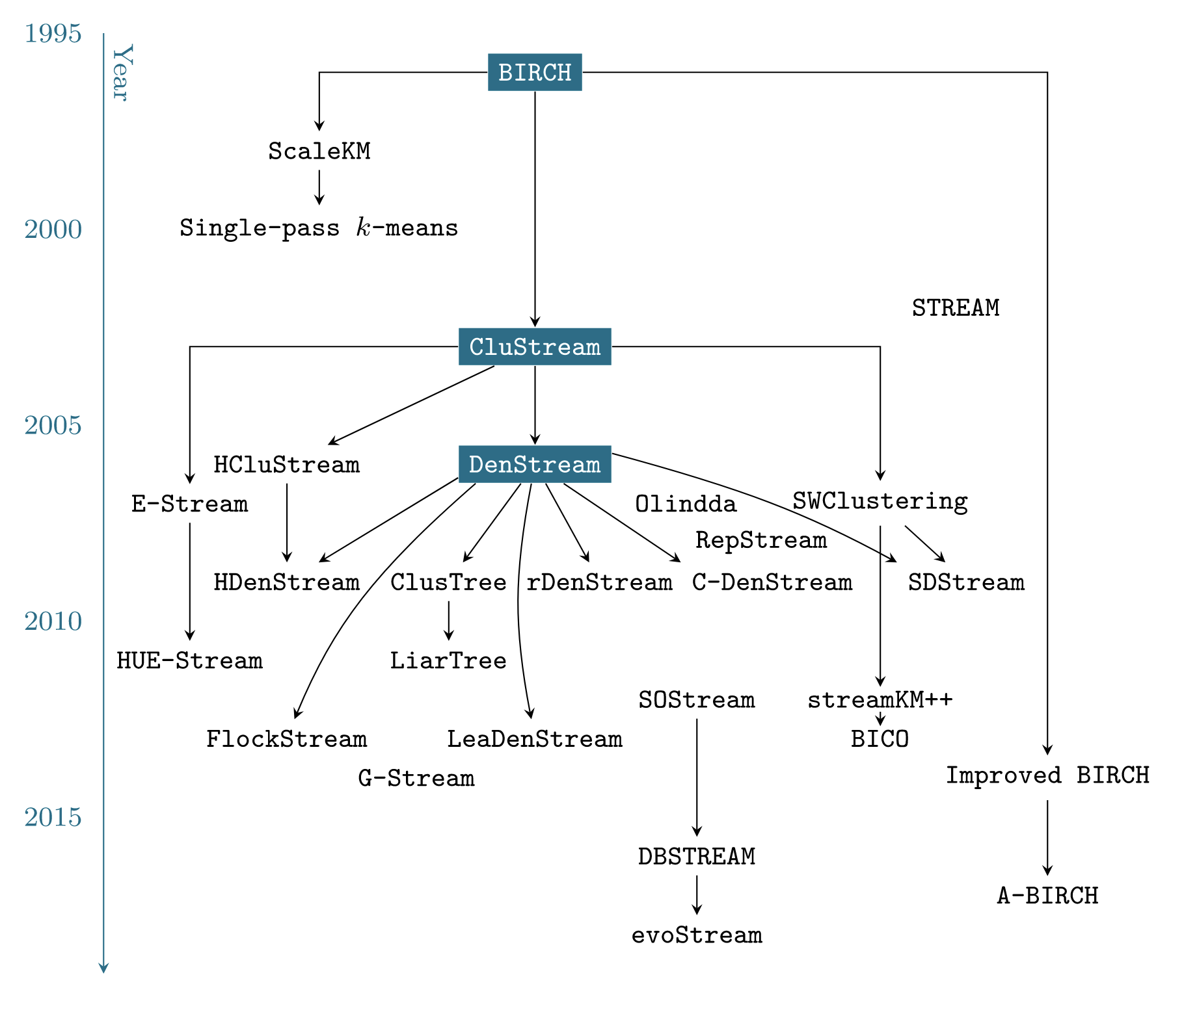
EVOLUTION OF ONLINE CLUSTERING ALGORITHS
Matthias Carnein and Heike Trautmann. 2019. Optimizing Data Stream Representation: An Extensive Survey on Stream Clustering Algorithm. Business & Information Systems Engineering, 61 (2019), 277-297. https://doi.org/10.1007/s12599-019-00576-5.

Slide 54
SIMPLEST IMPLEMENTED ALGORITHM: INCREMENTAL K-MEANS
Basically the simplest, naive approach that we can think of.
Most noticable parameter: halflife, which decides how much to move the cluster to the new point
Obtains comparable performance compared to more complicated algorithms, while maintaining a constantly low memory usage.

Slide 55
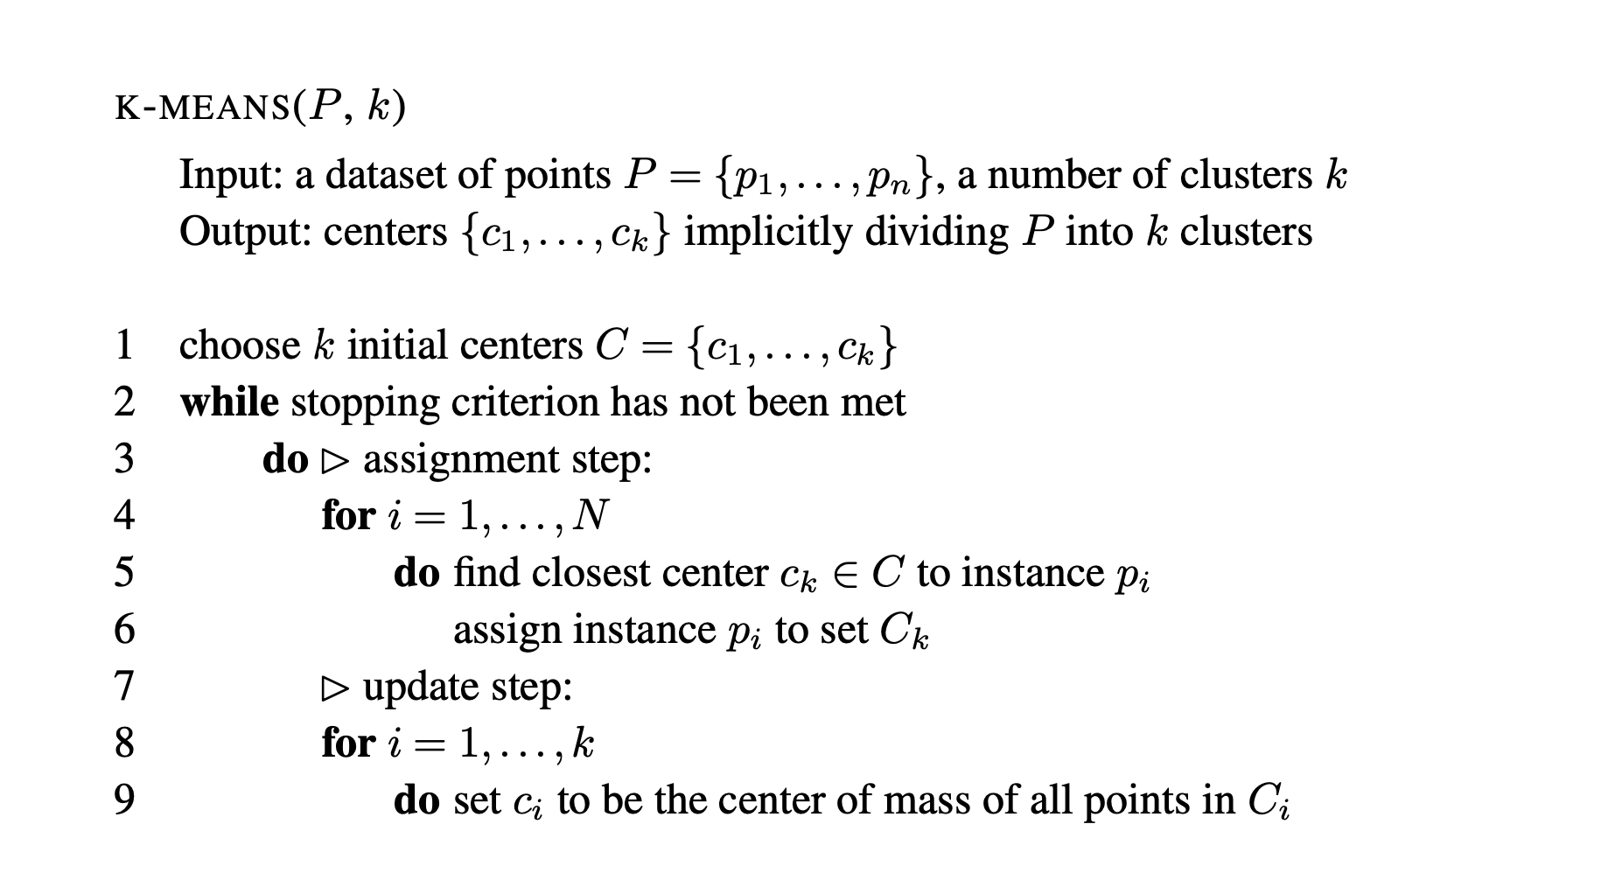
K-MEANS

Slide 56
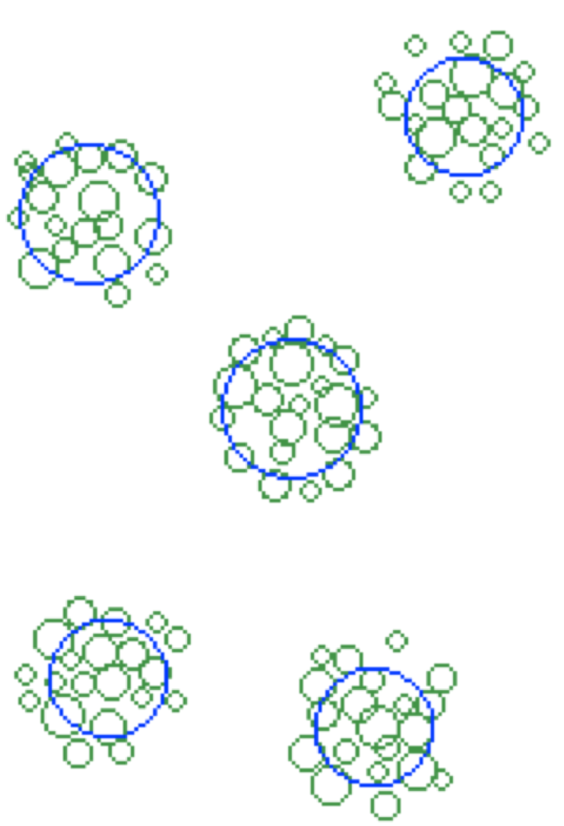
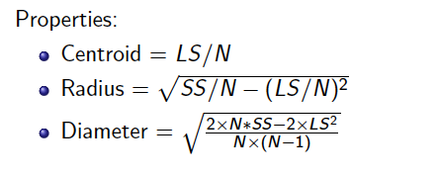
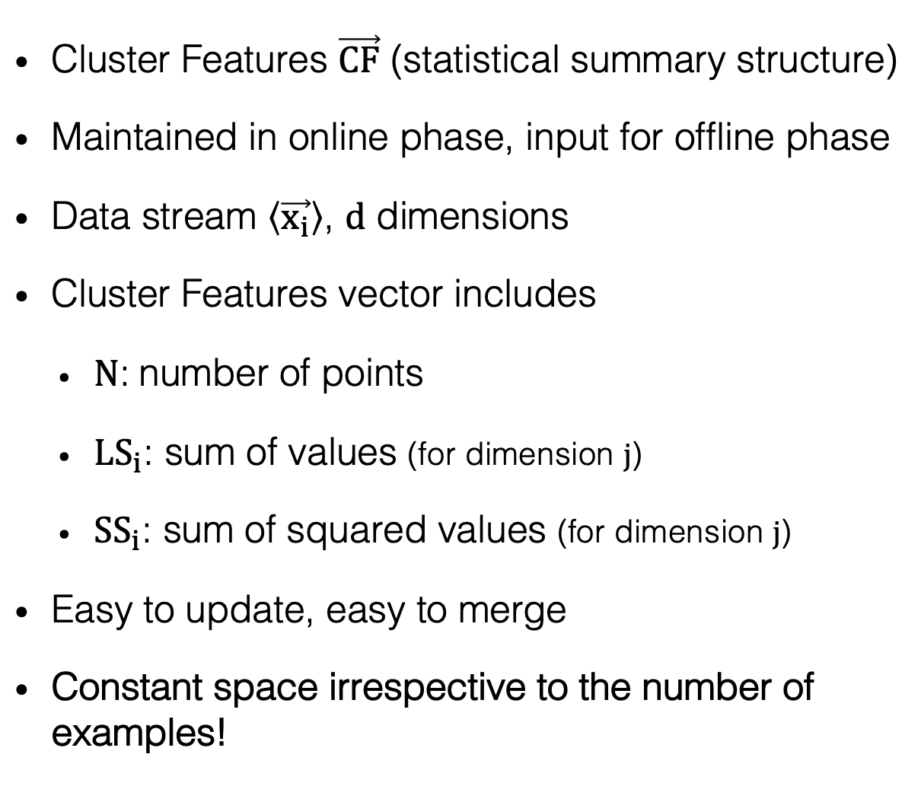
MICRO-CLUSTERS
Tian Zhang, Raghu Ramakrishnan, and Miron Livny. 1996. BIRCH: An Efficient Data Clustering Method for Very Large Databases. In SIGMOD’96: Proceedings of the 1996 ACM SIGMOD International Conference on Management of Data. Association for Computing Machinery, New York, NY, USA. https://doi.org/10.1145/233269.233324
Cluster Features $\vec{CF}$ (statistical summary structure)
Maintained in online phase, input for offline phase
Data stream $\left\langle \vec{x_{i}}\right\rangle$, $d$ dimensions
Cluster Features vector includes
$N$: number of points
${LS}_{i}$: sum of values (for dimension $j$)
${SS}_{i}$: sum of squared values (for dimension $j$)
Easy to update, easy to merge
Constant space irrespective to the number of examples!
Notes:
Assignment of point to micro-clusters: if points within boundary (or closest)

Slide 57
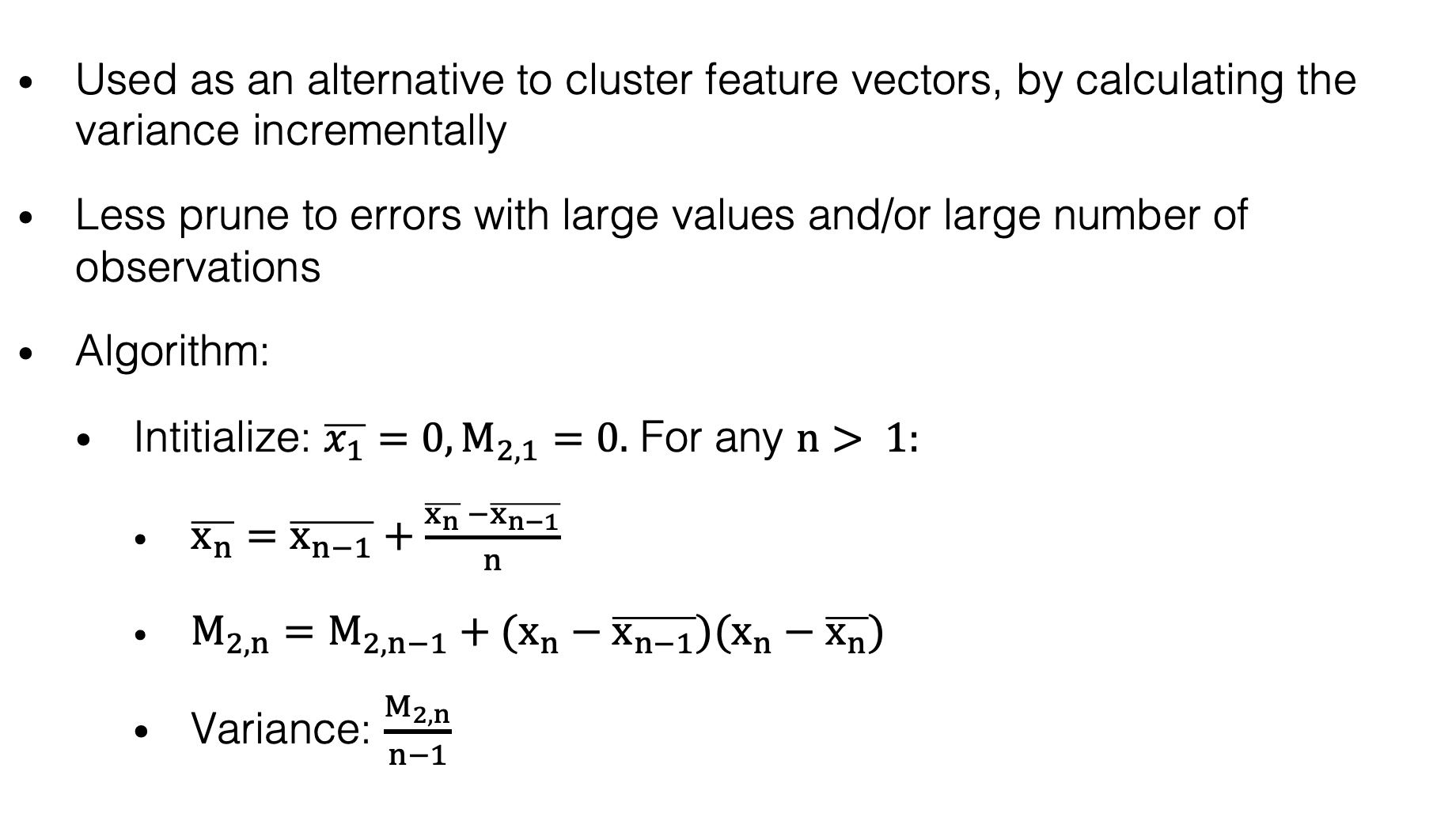
WELFORD’S ALGORITHM
Used as an alternative to cluster feature vectors, by calculating the variance incrementally
Less prune to errors with large values and/or large number of observations
Algorithm:
Intitialize: $\overline{x_{1}}=0, M_{2,1}=0.$ For any $n> 1:$
$\overline{x_{n}}=\overline{x_{n−1}}+\frac{\overline{x_{n}} −\overline{x_{n−1}}}{n}$
$M_{2,n}=M_{2,n−1}+(x_{n}−\overline{x_{n−1}})(x_{n}−\overline{x_{n}})$
Variance: $\frac{M_{2,n}}{n−1}$

Slide 58
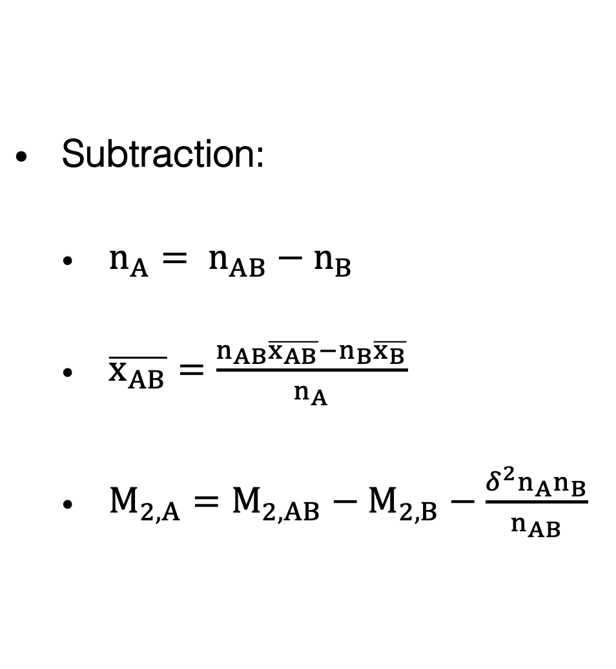
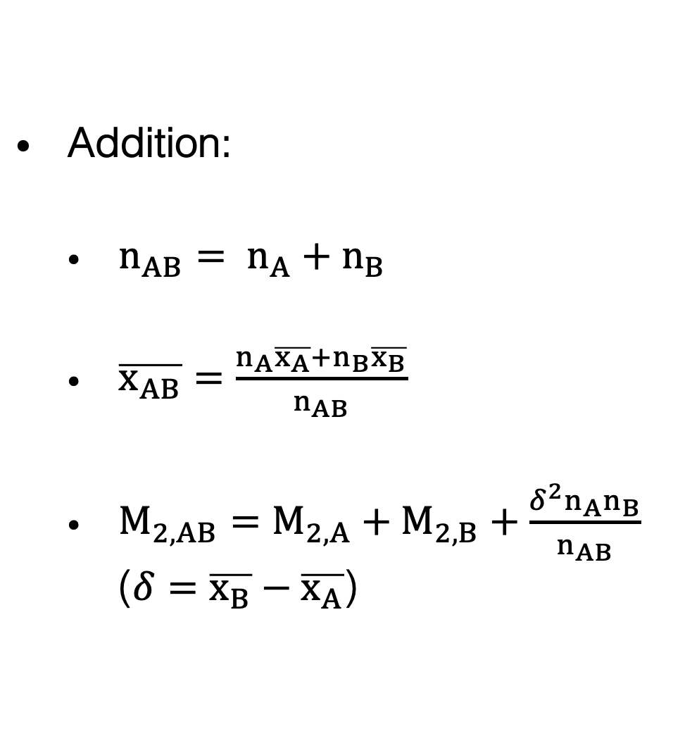
HANDLING ADDITION AND SUBTRACTION
Addition:
$n_{AB}= n_{A}+n_{B}$
$\overline{x_{AB}}=\frac{n_{A}\overline{x_{A}}+n_{B}\overline{x_{B}}}{n_{AB}}$
$M_{2,AB}=M_{2,A}+M_{2,B}+\frac{δ^{2}n_{A}n_{B}}{n_{AB}}$ ($δ=\overline{x_{B}}−\overline{x_{A}}$)
Subtraction:
$n_{A}= n_{AB}−n_{B}$
$\overline{x_{AB}}=\frac{n_{AB}\overline{x_{AB}}−n_{B}\overline{x_{B}}}{n_{A}}$
$M_{2,A}=M_{2,AB}−M_{2,B}−\frac{δ^{2}n_{A}n_{B}}{n_{AB}}$

Slide 59
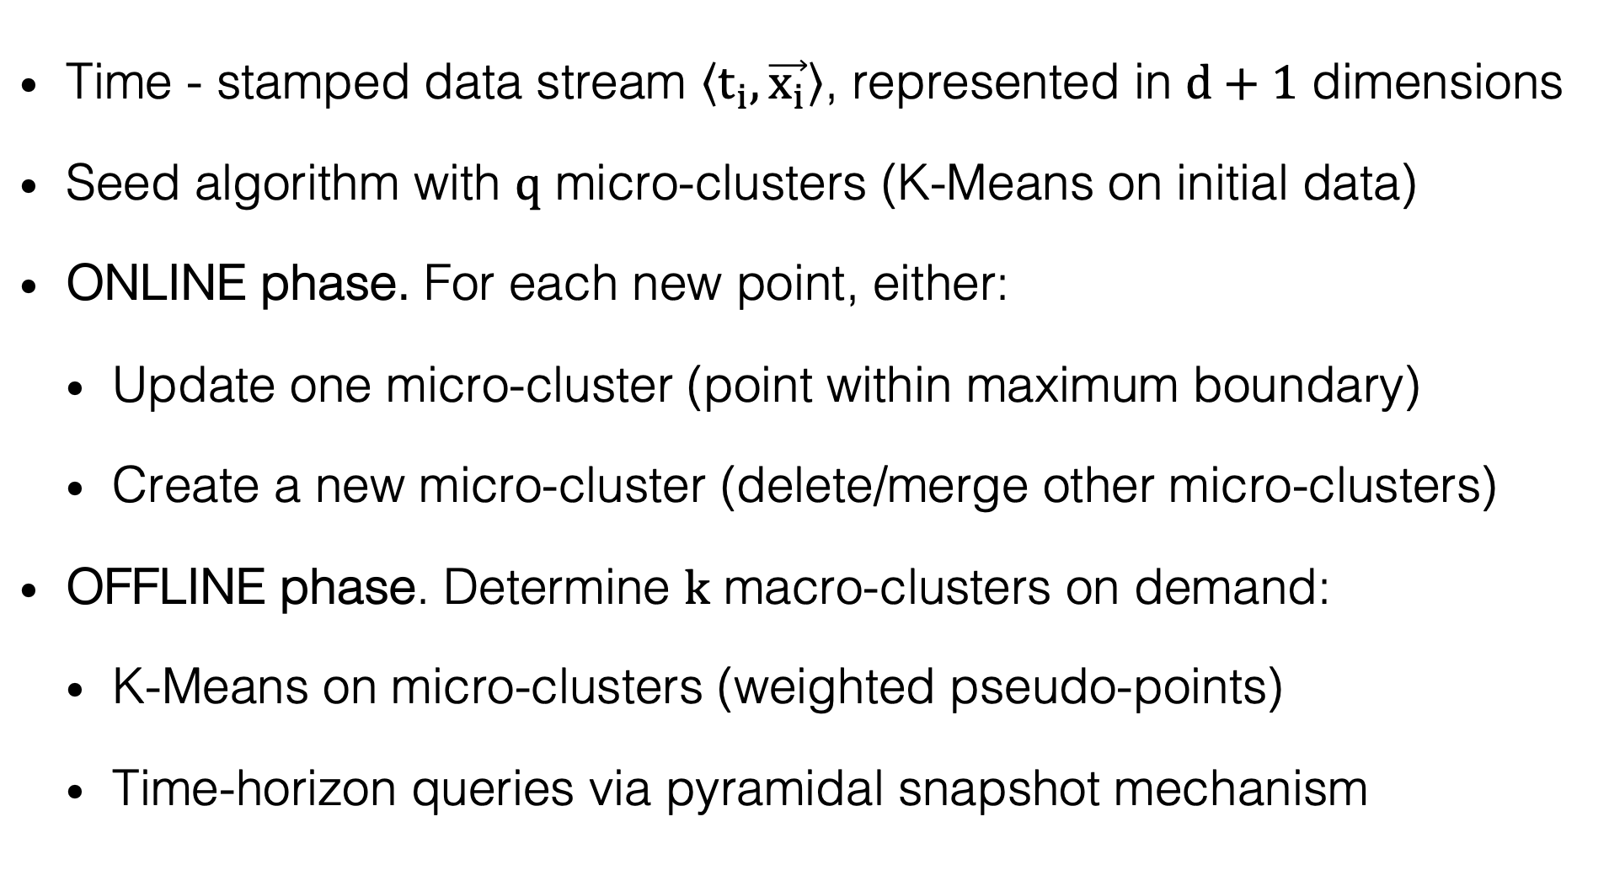
CLUSTREAM
Charu C. Aggarwal, Jiawei Han, Jianyong Wang, and Phillip S. Yu. 2003. A Framework for Clustering Evolving Data Streams. In: Proceedings of the 29th International Conference on Very Large Data Bases - Volume 29 (Berlin, Germany) (VLDB ’03). VLDB Endowment, Berlin, Germany, 81–92.
Time - stamped data stream $\left\langle t_{i},\vec{x_{i}}\right\rangle$, represented in $d+1$ dimensions
Seed algorithm with $q$ micro-clusters (K-Means on initial data)
ONLINE phase. For each new point, either:
Update one micro-cluster (point within maximum boundary)
Create a new micro-cluster (delete/merge other micro-clusters)
OFFLINE phase. Determine $k$ macro-clusters on demand:
K-Means on micro-clusters (weighted pseudo-points)
Time-horizon queries via pyramidal snapshot mechanism
Notes:
Seeds for offline k-means chosen proportionally to number of points in microcluster
Points are the centroid of the microclusters weighted by their number of points
Time-horizon queries by using a pyramidal snapshot mechanism

Slide 60
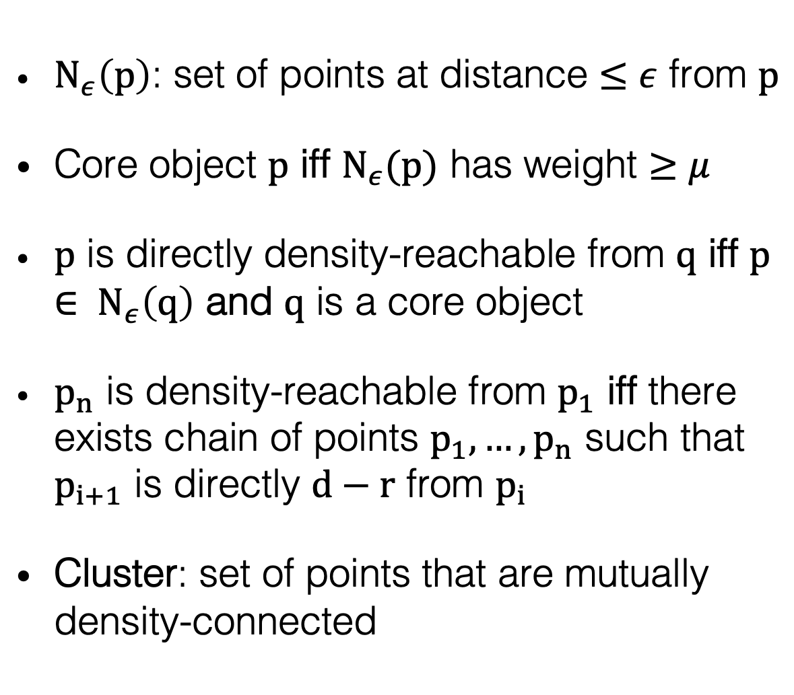
DBSCAN
Martin Ester and Hans-Peter Kriegel and Jörg Sander and Xiaowei Xu. 1996. A Density-Based Algorithm for Discovering Clusters in Large Spatial Databases with Noise. In KDD’96: Proceedings of the Second International Conference on Knowledge Discorvery and Data Mining. AAAI Press, 226-231. https://doi.org/10.5555/3001460.3001507
$N_{ε}\left(p\right)$: set of points at distance $≤ε$ from $p$
Core object $p$ iff $N_{ε}(p)$ has weight $≥μ$
$p$ is directly density-reachable from $q$ iff $p∈ N_{ε}\left(q\right)$ and $q$ is a core object
$p_{n}$ is density-reachable from $p_{1}$ iff there exists chain of points $p_{1},…,p_{n}$ such that $p_{i+1}$ is directly $d−r$ from $p_{i}$
Cluster: set of points that are mutually density-connected
Notes:
Non-spherical clusters
Weight µ depends on fading function

Slide 61
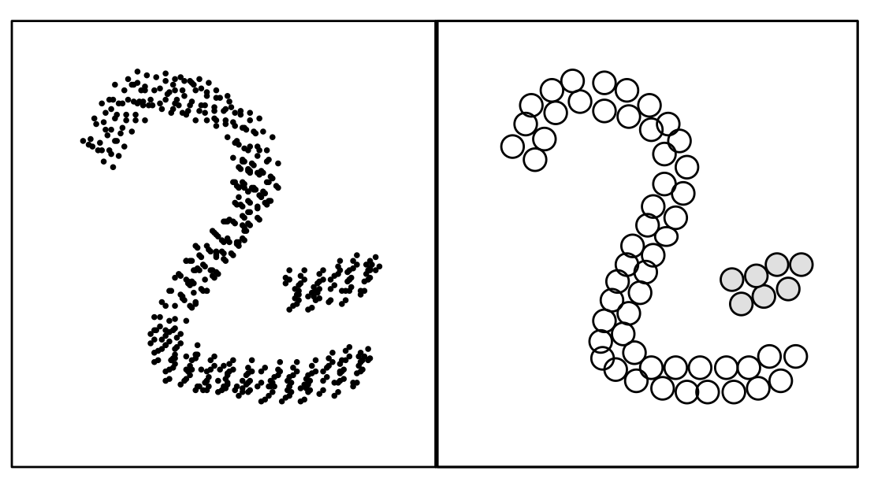
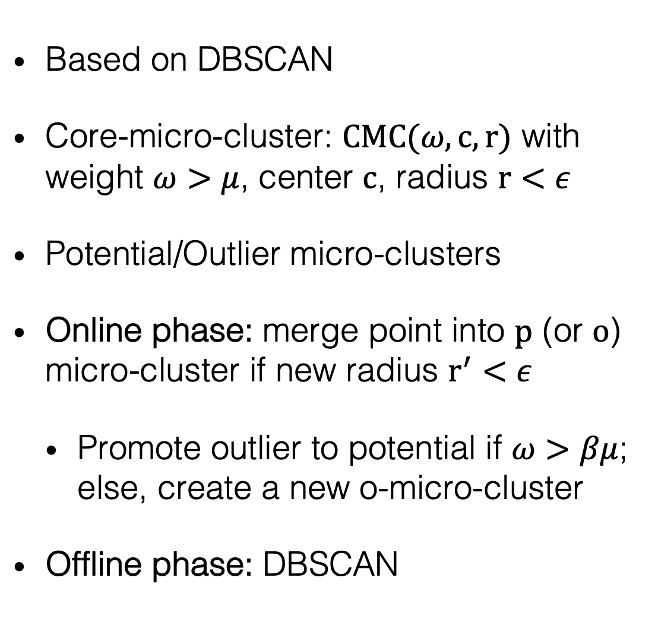
DENSTREAM
Feng Cao and Martin Ester and Weining Qian and Aoying Zhou. Density-Based Clustering over an Evolving Data Stream with Noise. In: Proceedings of the 2006 SIAM International Conference on Data Mining (SDM). Society for Industrial and Applied Mathematics (SIAM), 328-339. https://doi.org/10.1137/1.9781611972764.29
Based on DBSCAN
Core-micro-cluster: $CMC(ω,c,r)$ with weight $ω>μ$, center $c$, radius $r<ε$
Potential/Outlier micro-clusters
Online phase: merge point into $p$ (or $o$) micro-cluster if new radius $r^{′}<ε$
Promote outlier to potential if $ω>βμ$; else, create a new o-micro-cluster
Offline phase: DBSCAN
Notes:
Prune potential to outliers periodically

Slide 62
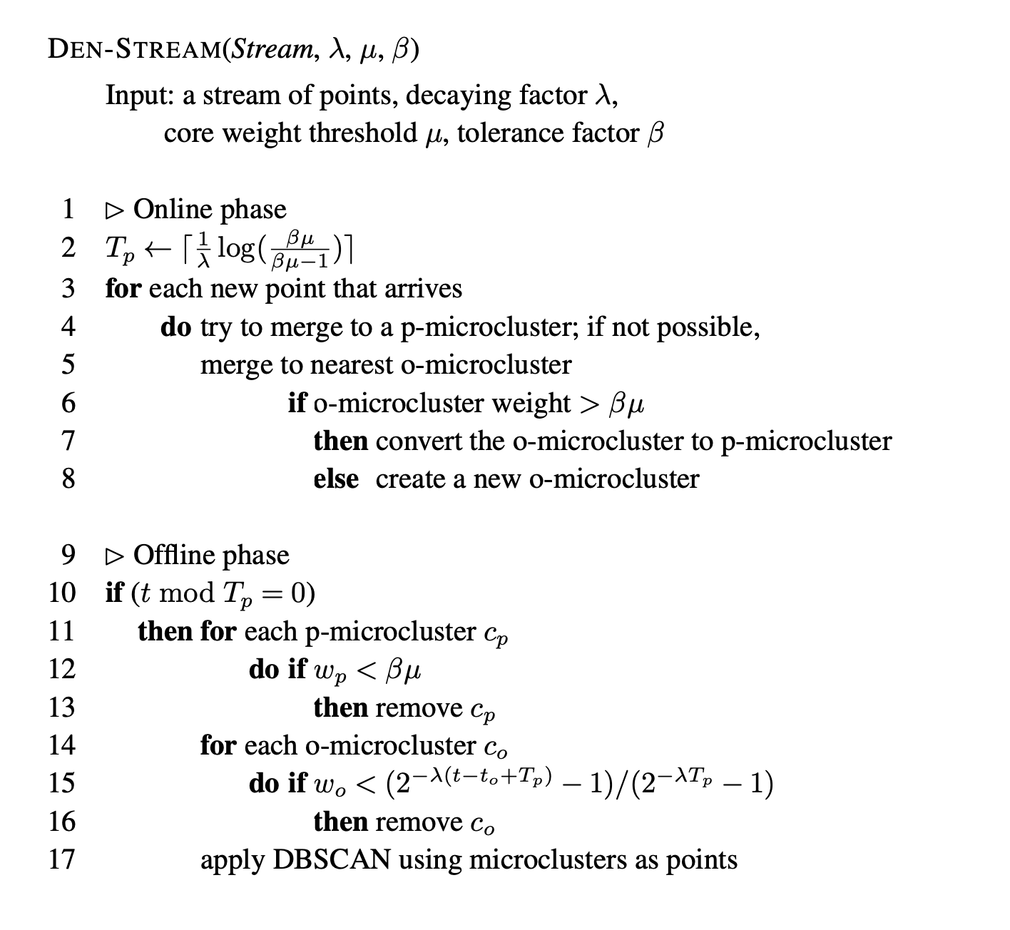
DENSTREAM
Feng Cao and Martin Ester and Weining Qian and Aoying Zhou. Density-Based Clustering over an Evolving Data Stream with Noise. In: Proceedings of the 2006 SIAM International Conference on Data Mining (SDM). Society for Industrial and Applied Mathematics (SIAM), 328-339. https://doi.org/10.1137/1.9781611972764.29
Notes:
Prune potential to outliers periodically

Slide 63
CLUSTREE
Philipp Kranen, Ira Assent, Corinna Baldauf, and Thomas Seidl. 2010. The ClusTree: indexing micro-clusters for anytime stream mining. Knowledge and Information Systems 29, 2 (2011). Springer, 249-272. https://doi.org/10.1007/s10115-010-0342-8
ClusTree: anytime clustering
Hierarchical data structure: logarithmic insertion complexity
Buffer and hitchhiker concept: enable anytime clustering
Exponential decay
Aggregation: for very fast streams
Notes:
Seeds for offline k-means chosen proportionally to number of points in microcluster
Points are the centroid of the microclusters weighted by their number of points
Time-horizon queries by using a pyramidal snapshot mechanism

Slide 64
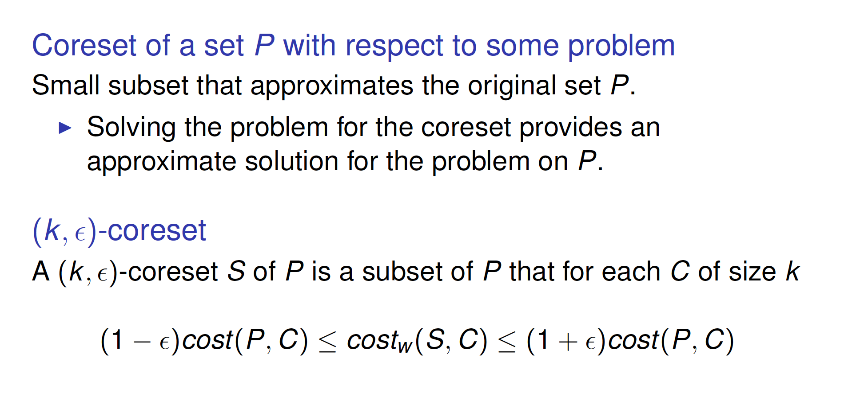
STREAMKM++
Marcel R. Ackermann, Marcus Märtens, Christoph Raupach, Kamil Swierkot, Christiane Lammersen, and Christian Sohler. 2012. StreamKM++: A clustering algorithm for data streams. ACM J. Exp. Algorithmics 17, 1 (2012) 2.1-2.30. https://doi.org/10.1145/2133803.2184450
Notes:
Seeds for offline k-means chosen proportionally to number of points in microcluster
Points are the centroid of the microclusters weighted by their number of points
Time-horizon queries by using a pyramidal snapshot mechanism

Slide 65
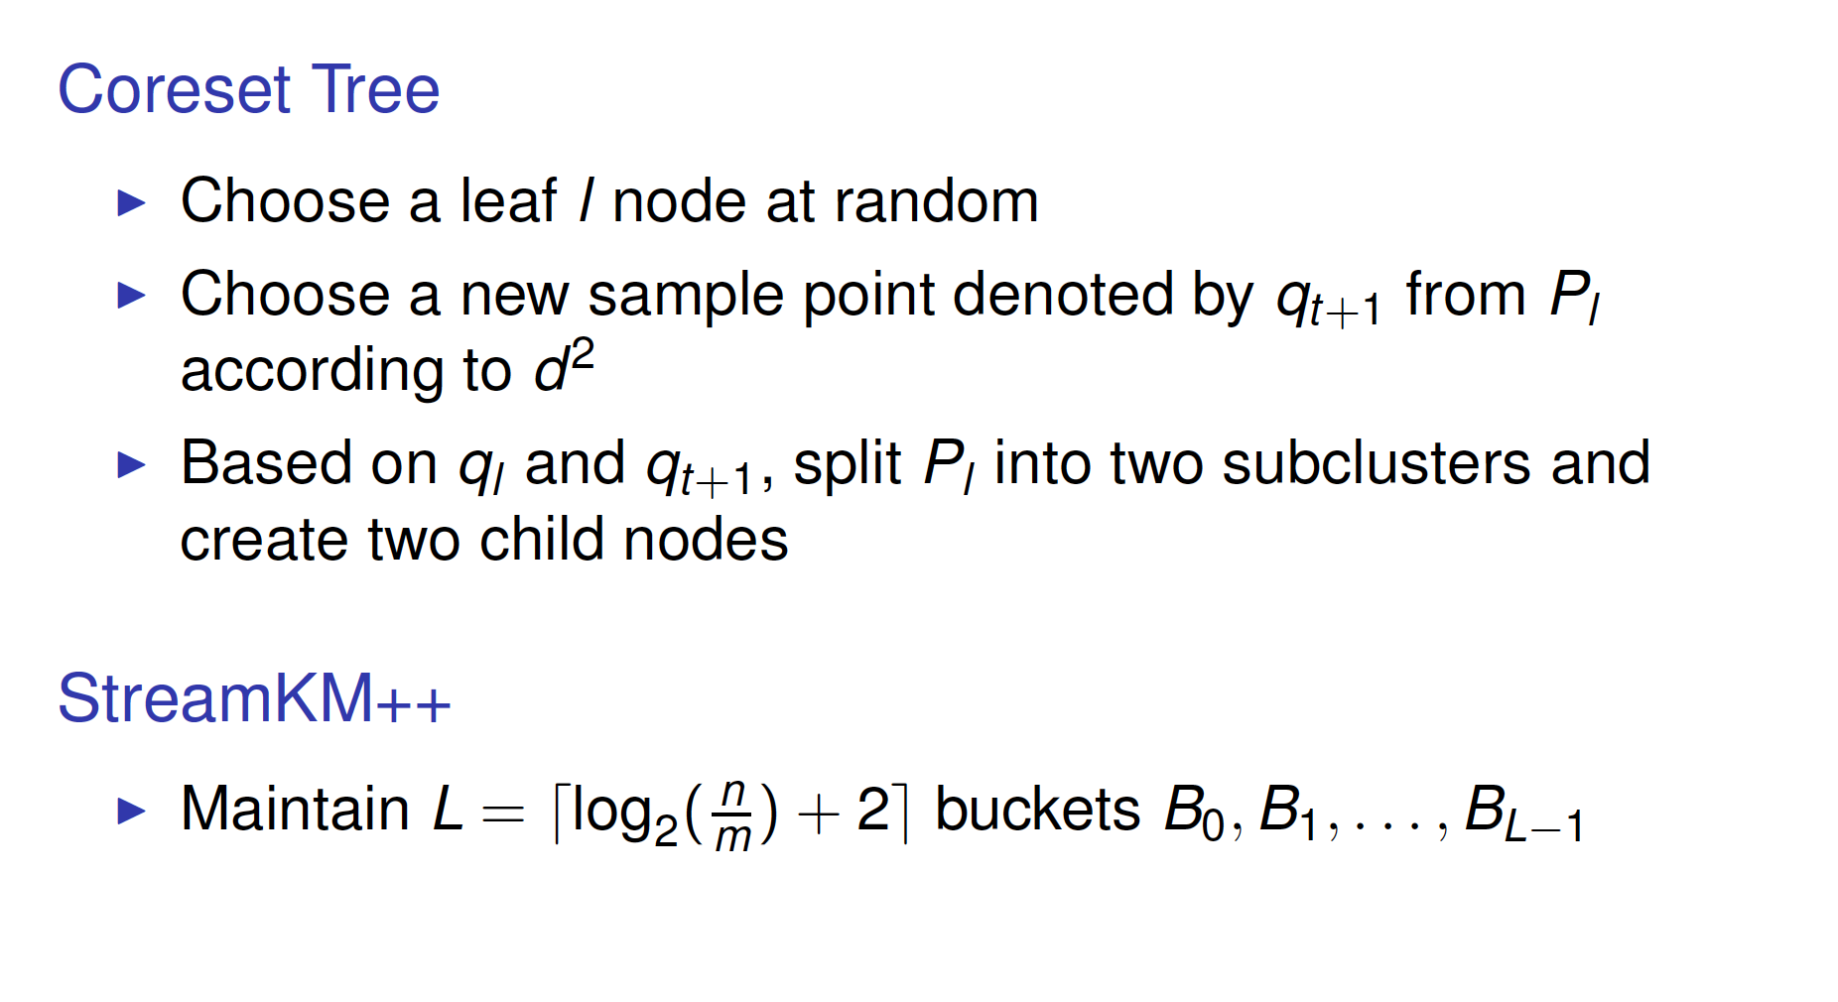
STREAMKM++
Marcel R. Ackermann, Marcus Märtens, Christoph Raupach, Kamil Swierkot, Christiane Lammersen, and Christian Sohler. 2012. StreamKM++: A clustering algorithm for data streams. ACM J. Exp. Algorithmics 17, 1 (2012) 2.1-2.30. https://doi.org/10.1145/2133803.2184450
Notes:
Seeds for offline k-means chosen proportionally to number of points in microcluster
Points are the centroid of the microclusters weighted by their number of points
Time-horizon queries by using a pyramidal snapshot mechanism

Slide 66
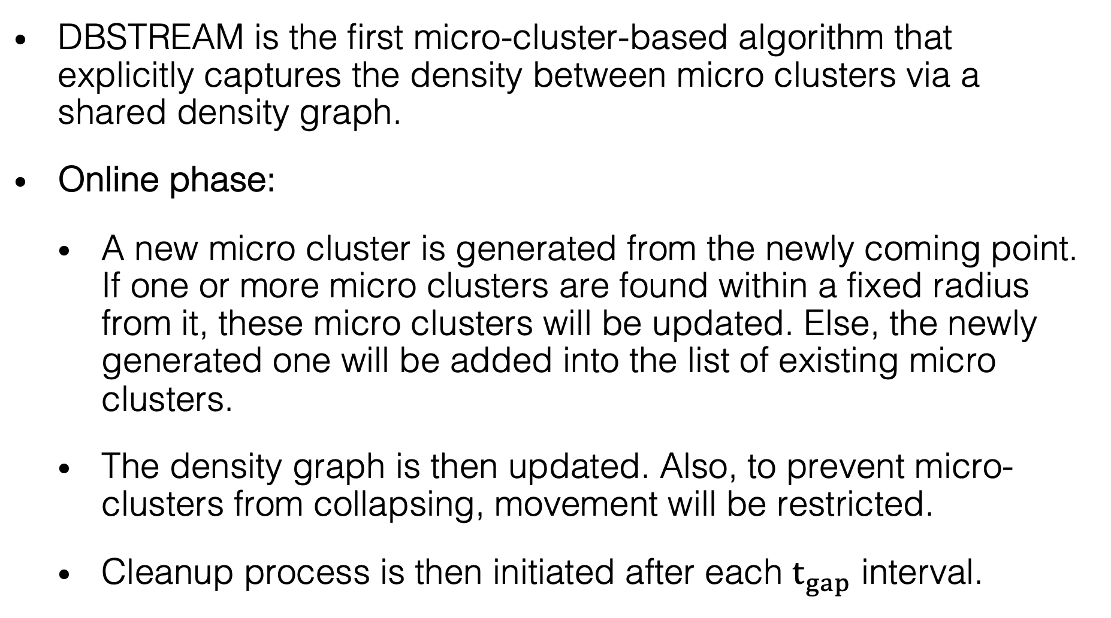
DBSTREAM
Michael Hashler and Matthew Bolanos. 2016. Clustering Data Streams Based on Shared Density between Micro-Clusters. IEEE Transactions on Knowledge and Data Engineering 28, 6 (2016), 1449-1461. https://doi.org/10.1109/TKDE.2016.2522412
DBSTREAM is the first micro-cluster-based algorithm that explicitly captures the density between micro clusters via a shared density graph.
Online phase:
A new micro cluster is generated from the newly coming point. If one or more micro clusters are found within a fixed radius from it, these micro clusters will be updated. Else, the newly generated one will be added into the list of existing micro clusters.
The density graph is then updated. Also, to prevent micro-clusters from collapsing, movement will be restricted.
Cleanup process is then initiated after each $t_{gap}$ interval.

Slide 67
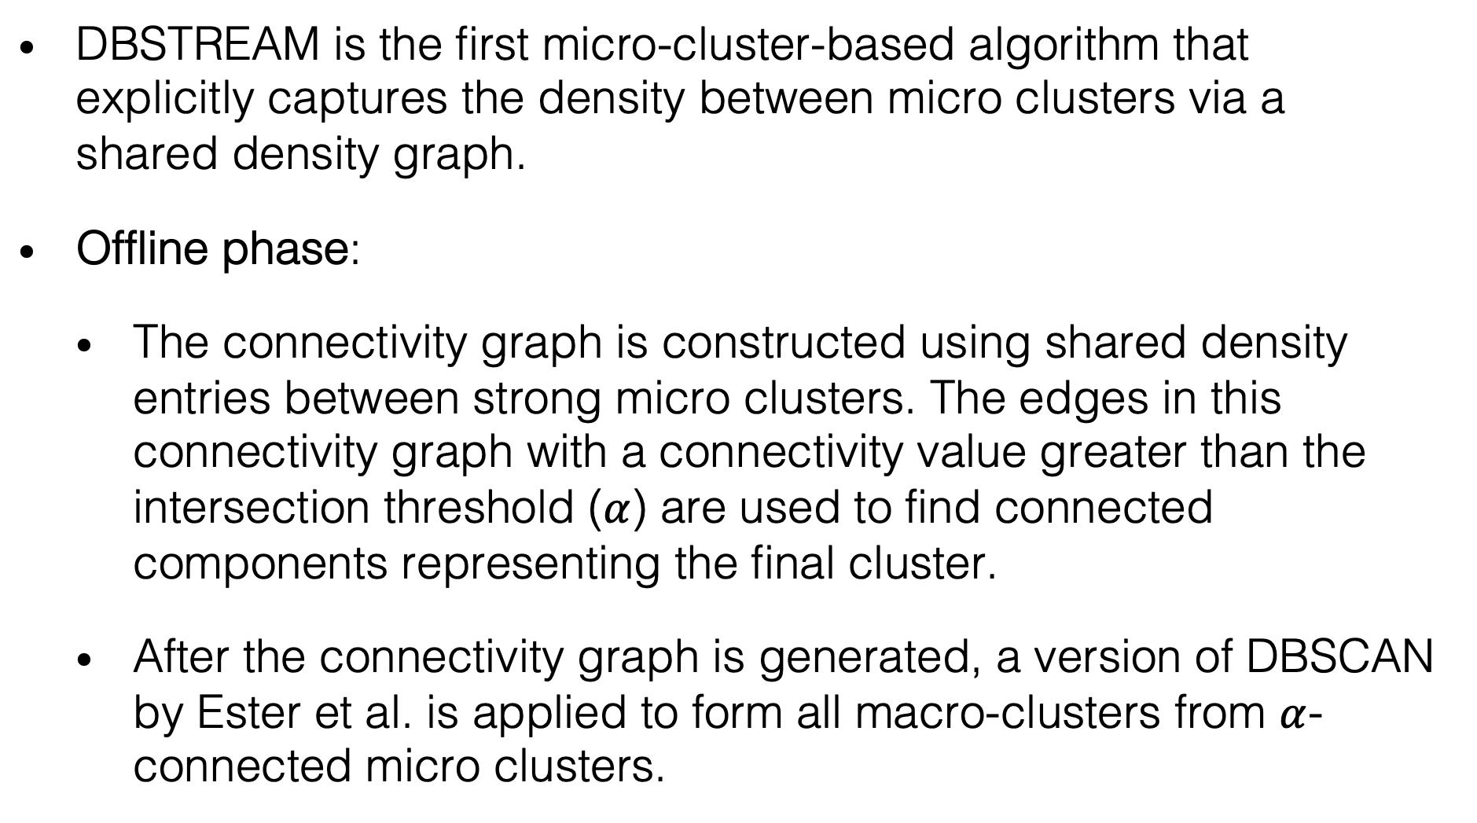
DBSTREAM
Michael Hashler and Matthew Bolanos. 2016. Clustering Data Streams Based on Shared Density between Micro-Clusters. IEEE Transactions on Knowledge and Data Engineering 28, 6 (2016), 1449-1461. https://doi.org/10.1109/TKDE.2016.2522412
DBSTREAM is the first micro-cluster-based algorithm that explicitly captures the density between micro clusters via a shared density graph.
Offline phase:
The connectivity graph is constructed using shared density entries between strong micro clusters. The edges in this connectivity graph with a connectivity value greater than the intersection threshold ($α$) are used to find connected components representing the final cluster.
After the connectivity graph is generated, a version of DBSCAN by Ester et al. is applied to form all macro-clusters from $α$-connected micro clusters.

Slide 68
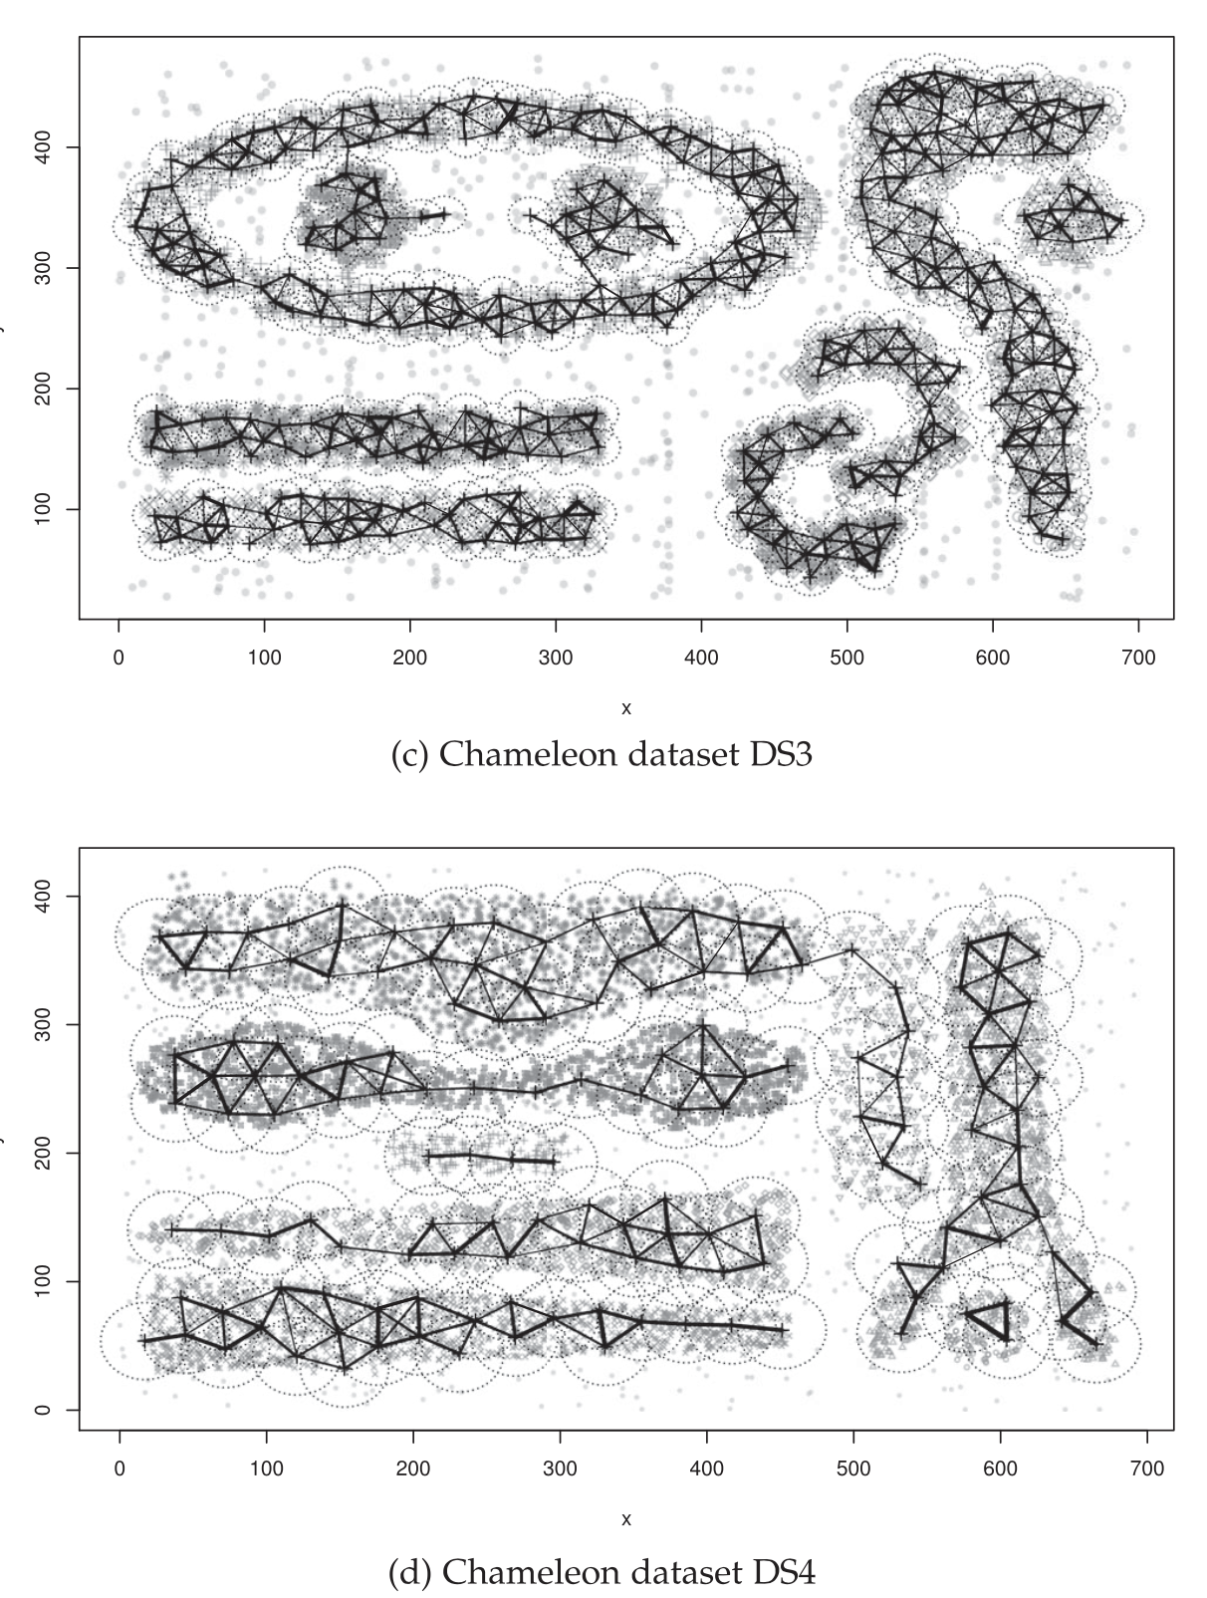

DBSTREAM
Michael Hashler and Matthew Bolanos. 2016. Clustering Data Streams Based on Shared Density between Micro-Clusters. IEEE Transactions on Knowledge and Data Engineering 28, 6 (2016), 1449-1461. https://doi.org/10.1109/TKDE.2016.2522412

Slide 69
EVOSTREAM
Matthias Carnein and Heike Trautmann. 2018. evoStream – Evolutionary Stream Clustering Utilizing Idle Time. Big Data Research 14 (2018), 101-111. https://doi.org/10.1016/j.bdr.2018.05.005
A fairly new online clustering algorithm.
evoStream employs an evolutionary algorithm, first introduced by Maulik U. and Bandyopadhyay S. (2000), to utilize “idle” time efficiently to find better macro-cluster solutions.
In the evolution algorithm, promising solutions are combined to create offsprings which can combine the best attributes of both parents.
Include two phases: Micro-cluster maintenance (online learning phase) and evolutionary step of micro-cluster generation (offline phase)

Slide 70

EVOSTREAM
Matthias Carnein and Heike Trautmann. 2018. evoStream – Evolutionary Stream Clustering Utilizing Idle Time. Big Data Research 14 (2018), 101-111. https://doi.org/10.1016/j.bdr.2018.05.005
evoStream algorithm (with both online and offline phase)

Slide 71


EVOSTREAM
Matthias Carnein and Heike Trautmann. 2018. evoStream – Evolutionary Stream Clustering Utilizing Idle Time. Big Data Research 14 (2018), 101-111. https://doi.org/10.1016/j.bdr.2018.05.005
Cleanup phase (after each $t_{gap}$ time interval)

Slide 72

EVOSTREAM
Matthias Carnein and Heike Trautmann. 2018. evoStream – Evolutionary Stream Clustering Utilizing Idle Time. Big Data Research 14 (2018), 101-111. https://doi.org/10.1016/j.bdr.2018.05.005
Evolution algorithm (during idle time)

Slide 73
TEXTCLUST
Assenmacher, D., Trautmann, H. (2022). Textual One-Pass Stream Clustering with Automated Distance Threshold Adaption. In: Nguyen, N.T., Tran, T.K., Tukayev, U., Hong, TP., Trawiński, B., Szczerbicki, E. (eds) Intelligent Information and Database Systems. ACIIDS 2022. Lecture Notes in Computer Science(), vol 13757. Springer, Cham. https://doi.org/10.1007/978-3-031-21743-2_1
TF-IDF (Term frequency – inverse document frequency) based text stream clustering algorithm, using an automated distance threshold adaption technique for document insertion and cluster merging.
textClust uses the popular two-phase approach: The online phase will be used to summarize data coming in a real time manner into micro-clusters, while the offline phase will be used to create macro-clusters on demand.
To keep micro-clusters up-to-date, a fading strategy is applied where micro-clusters that are not updated regularly gradually loses relevance.

Slide 74
TEXTCLUST
Assenmacher, D., Trautmann, H. (2022). Textual One-Pass Stream Clustering with Automated Distance Threshold Adaption. In: Nguyen, N.T., Tran, T.K., Tukayev, U., Hong, TP., Trawiński, B., Szczerbicki, E. (eds) Intelligent Information and Database Systems. ACIIDS 2022. Lecture Notes in Computer Science(), vol 13757. Springer, Cham. https://doi.org/10.1007/978-3-031-21743-2_1
The algorithm can be described as follows:
First, the algorithm reads a new text x, which will go through the preprocessing step and be split into individual tokens.
The remain list of tokens will be used to construct n-grams, and a new virtual MC is constructed. Then, IDF vector across all documents are computed, which will then be used to calculate the TF-IDF representations of each existing and the new virtual MC. The closest MC becomes the candidate for merging

Slide 75
TEXTCLUST
Assenmacher, D., Trautmann, H. (2022). Textual One-Pass Stream Clustering with Automated Distance Threshold Adaption. In: Nguyen, N.T., Tran, T.K., Tukayev, U., Hong, TP., Trawiński, B., Szczerbicki, E. (eds) Intelligent Information and Database Systems. ACIIDS 2022. Lecture Notes in Computer Science(), vol 13757. Springer, Cham. https://doi.org/10.1007/978-3-031-21743-2_1
The algorithm can be described as follows:
Next, check whether the candidate is close enough to the new MC for both to be merged.
If yes, the new virtual MC is merged into the candiate cluster, and the cluster’s weight will be decayed to the current time.
If no, the temporary MC will be added to all the clusters.
Finally, clean-up after each time gap.

Slide 76

TEXTCLUST
Assenmacher, D., Trautmann, H. (2022). Textual One-Pass Stream Clustering with Automated Distance Threshold Adaption. In: Nguyen, N.T., Tran, T.K., Tukayev, U., Hong, TP., Trawiński, B., Szczerbicki, E. (eds) Intelligent Information and Database Systems. ACIIDS 2022. Lecture Notes in Computer Science(), vol 13757. Springer, Cham. https://doi.org/10.1007/978-3-031-21743-2_1
textClust outperforms state-of-the-art one-pass and batch-based stream clustering algorithms (Estream, MSTREAM, OSDM, etc.)

Slide 77


EVALUATION
Holdout an independent test set
Apply the current model to the test set, at regular time intervals
Unbiased performance estimation
Popular in batch and stream learning
Prequential
Test then train each new instance
Order matters!
All data is used for training
Performance is estimated on the sequence
Popular in the stream setting

Slide 78
CLASSICAL STATIC EVALUATION
4 basic internal (validation) metrics include
Cohesion: The average distance from a point in the dataset to its assigned cluster centroid. The smaller the better.
SSQ: The sum of squared distances from data points to their assigned centroids. Closely related to cohesion. The smaller the better.
Separation: Average distance from a point to the points assigned to other clusters. The larger the better.
Silhouette coefficient: the ratio between cohesion and the average distances from the points to their second-closest centroid.

Slide 79

CLASSICAL STATIC EVALUATION
External validation metrics, requiring ground truth values, is mostly based on the following concepts
Accuracy: Fraction of the points assigned to their “correct” cluster.
Recall: Fraction of the points of a cluster that are in fact assigned to it.
Precision: Fraction of the points assigned to a cluster that truly belong to it.
Purity: In a maximally pure clustering, all points in the cluster belong to the same ground-truth class or cluster. Formally, purity is

Slide 80
INTERNAL METRICS: ARE THEY REALLY ONLINE?
Leonardo Enzo Brito Da Silva, Niklas Max Melton and Donald C. Wunsch. 2022. Incremental Cluster Validity Indices for Online Learning of Hard Partitions: Extensions and Comparative Study. IEEE Access, 8 (2020), 22025-22047. https://doi.org/10.1109/ACCESS.2020.2969849.
In 2020, Leonardo Enzo Brito Da Silva et al. introduced a new approach for incremental validity indices. This allows an update to a new value from a previous old value.
However, this approach still has one huge limitation: ALL information of each previous data points still have to be available.
As such, there is a requirement to come up with metrics that are truly incremental (facilitating the fashion of learning one sample at a time).

Slide 81

HOW TO DESIGN AN INCREMENTAL INTERNAL METRIC?
Save the information that are needed, finite and require low computational time/resources:
Linear sum and/or sum of squares of distances of point $x^{t}$ at time $t$ to the nearest cluster center at the same time, i.e ${\sum_{t}{\left\|v_{c_{t}}^{t}−x^{t}\right\|}}_{1/2}$
Number of points passed (in total and/or within each cluster)
Centers and centroids of clusters (using incremental means)
Centers of the whole dataset
etc.

Slide 82
INCREMENTAL EVALUATION
In River, static evaluation metrics can be modified to continuously evaluate data streams as follows:
External metrics: All external metrics implemented in River share the same confusion matrix, thus reducing the amount of occupied storage and computational time. This confusion matrix can easily be updated once a new predicted label and its ground truth arrive.
Internal metrics: Since information on previous data points are totally discarded once a new data point arrives, traditional internal metrics cannot be used incrementally. Instead, they are slightly modified by saving the most essential information based on requirement, for example linear sum and sum of squares of data points in the same cluster, distance from data point to assigned and/or second closest cluster centre at the time of update, etc.

Slide 83
INCREMENTAL EVALUATION
With 20 internal metrics and 18 external metrics, River is currently the package with the highest number of metrics offered for data stream continuous or incremental validation.
Internal metrics: Cohesion, SSB, SSW, Separation, Silhouette, Ball-Hall, CH, Hartigan, WB, Xie-Beni, Xu, (Root) Mean Squared Standard Deviation, R-Squared, I Index, Davies-Bouldin, Partition Separation, Dunn’s indices 43 and 53, SD Validation Index, and Bayesian Information Criterion.
External metrics: Completeness, Homogeneity, VBeta, (Adjusted, Expected, Normalized) Mutual Information, Q0 and Q2, Fowlkes-Mallows, Markedness, Informedness, Matthews Correlation Coefficient, (Adjusted) Rand Index, Purity, Prevalence Threshold, and Sorensen-Dice index.

Slide 84
INCREMENTAL EVALUATION
Every metric (both internal and external) in River contains the following attributes:
cm: Confusion matrix;
update and revert: Allow the metric to be updated with a new observation, or reverted to the previous state;
get: Obtain the exact value of the metric;
bigger-is-better: Indicate whether the metric has the property of the bigger, the better the clustering solution is;
work_with: Indicate whether the metrics work with algorithms of which type (clustering, classification, regression, etc.);
Notes:
Bigger-is-better: useful to evaluate whether newly implemented algorithms work as planned

Slide 85
STREAMING EVALUATION
Hardy Kremer, Philipp Kranen, Timm Jansen, Thomas Seidl, Albert Bifet, Geoff Holmes, Bernhard Pfahringer. 2011. An effective evaluation measure for clustering on evolving data streams. In: KDD ’11 Proceedings of the 17th ACM SIGKDD International Conference on Knowledge Discovery and Data Mining. Association for Computing Machinery, New York, NY, USA, 868-876. https://doi.org/10.1145/2020408.2020555
Clusters may: appear, fade, move, merge
Missed points (unassigned)
Misplaced points (assigned to different cluster)
Noise
Cluster Mapping Measure CMM
External (ground truth)
Normalized sum of penalties of these errors
Notes:
Evolving clusters have different and changing densities
Normalize by the connectivity of the class/cluster (difficulty of the clustering)

Slide 86
FURTHER STEPS
Benchmarking
Implementation of more clustering algorithms and/or improvement in performance of current ones
Text-specific clustering algorithms (competitors with textClust)

Slide 87
PERSONAL THOUGHTS
The world of online clustering is still “chaotic”, with a lot of papers having no official implementation or implementations scattered in different frameworks/languages → Hard to evaluate.
Are we too much dependent on the concept of online and offline phase while doing online clustering?
Online deep clustering (ODC) with the assistance of river-torch? (https://arxiv.org/abs/2006.10645)

Slide 88

Thank you for your attention!

Slide 89
ONLINE CLUSTERING: ALGORITHMS, EVALUATION, METRICS, APPLICATIONS AND BENCHMARKING
Jacob Montiel, Hoang-Anh Ngo, Minh-Huong Le Nguyen, Albert Bifet
KDD 2022, Washington, D.C., United States

